Slide 1
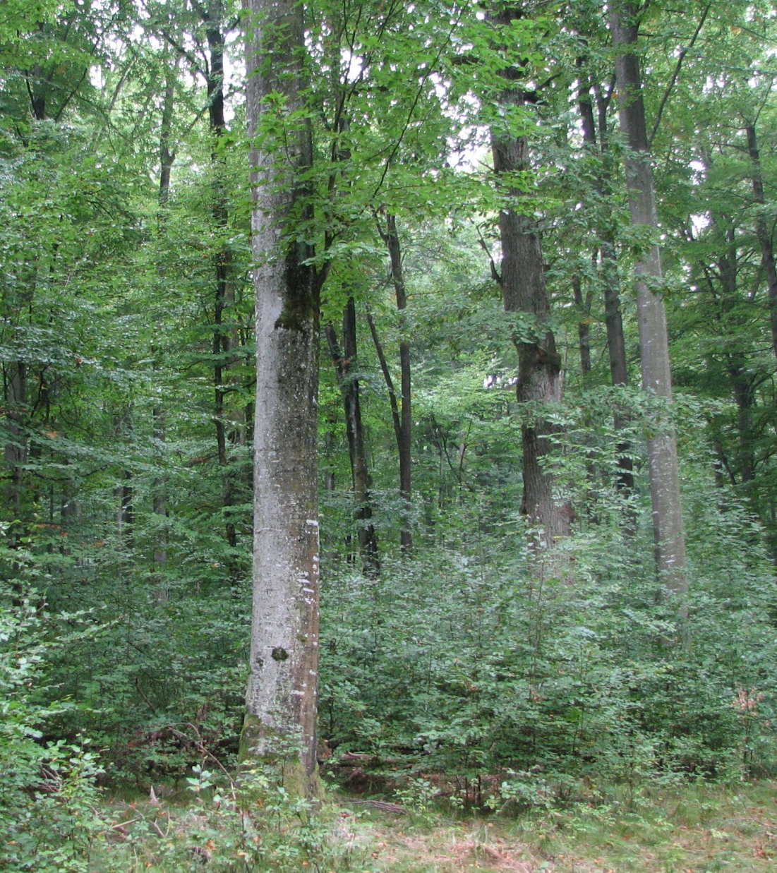
European Hardwoods for the Building Sector (EU Hardwoods)
Project meeting / 2014-12-19 / MPA Stuttgart
Hardwood resources in Europe
Lorenz Breinig

Slide 2
Quantification of recent resources in Europe (WP1.1)

Slide 3
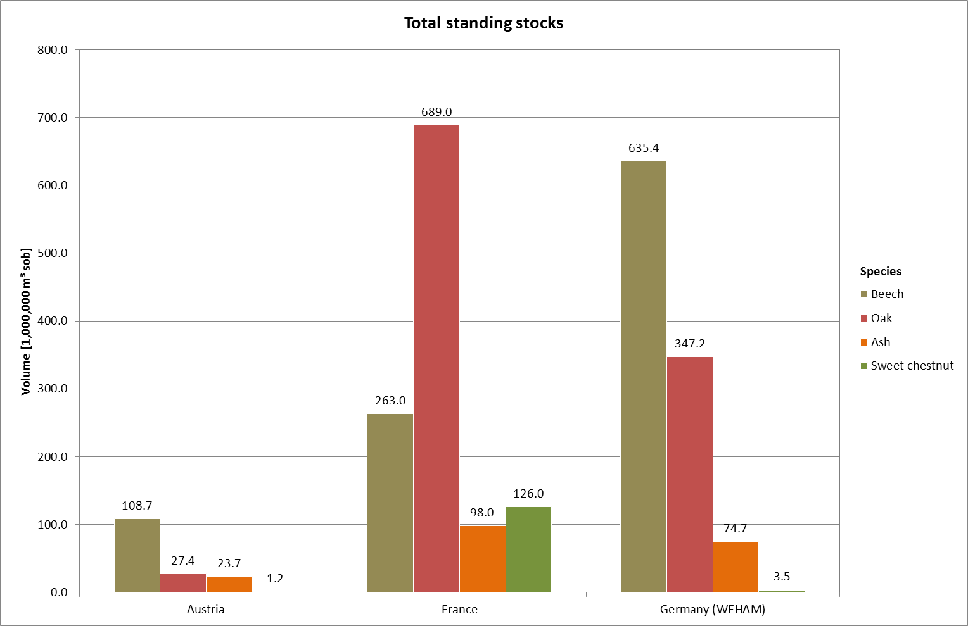
Hardwood resources in Austria, France and Germany

Slide 4
Hardwood resources in Austria
Standing stocks
Results from the inventory 2007/09; data provided by BFW (Wolfgang Russ)
Standing stock in production forests, living trees with DBH ≥ 7 cm
In cubic metres solid over bark (m³ sob)
Annual harvest
Reported by the Austrian ministry of agriculture (Bundesministerium für Land- und Forstwirtschaft, Umwelt und Wasserwirtschaft)
In cubic metres solid under bark (m³ sub)

Slide 5
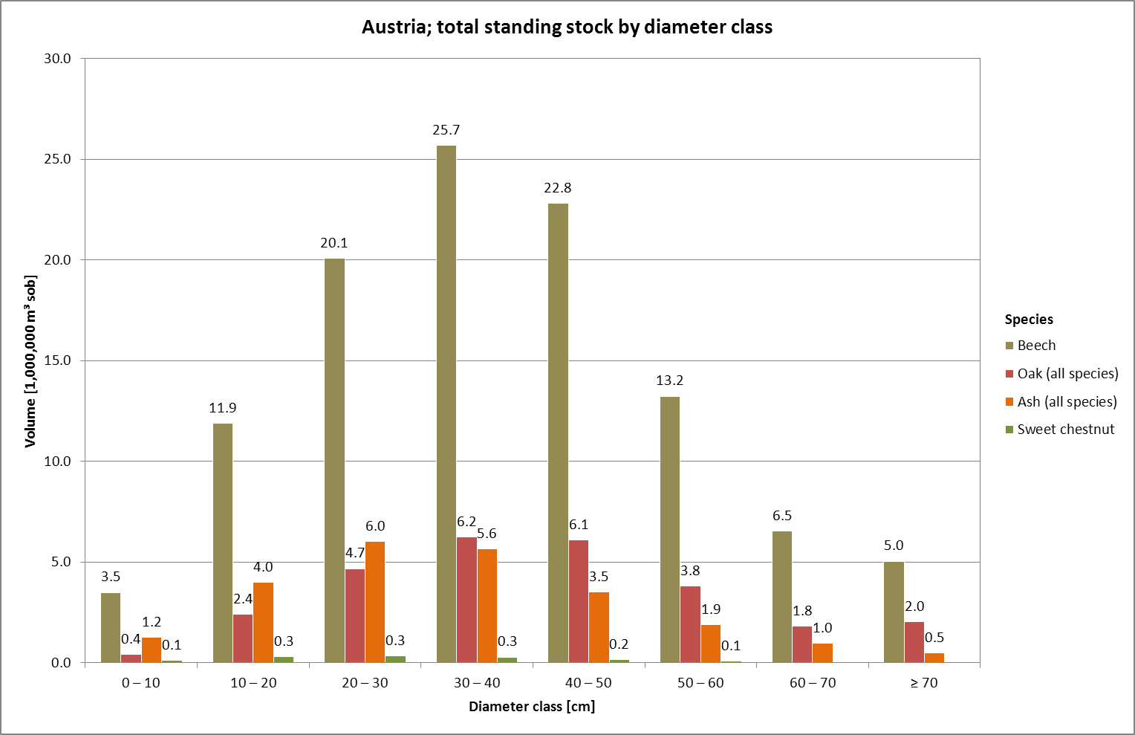
Hardwood resources in Austria

Slide 6
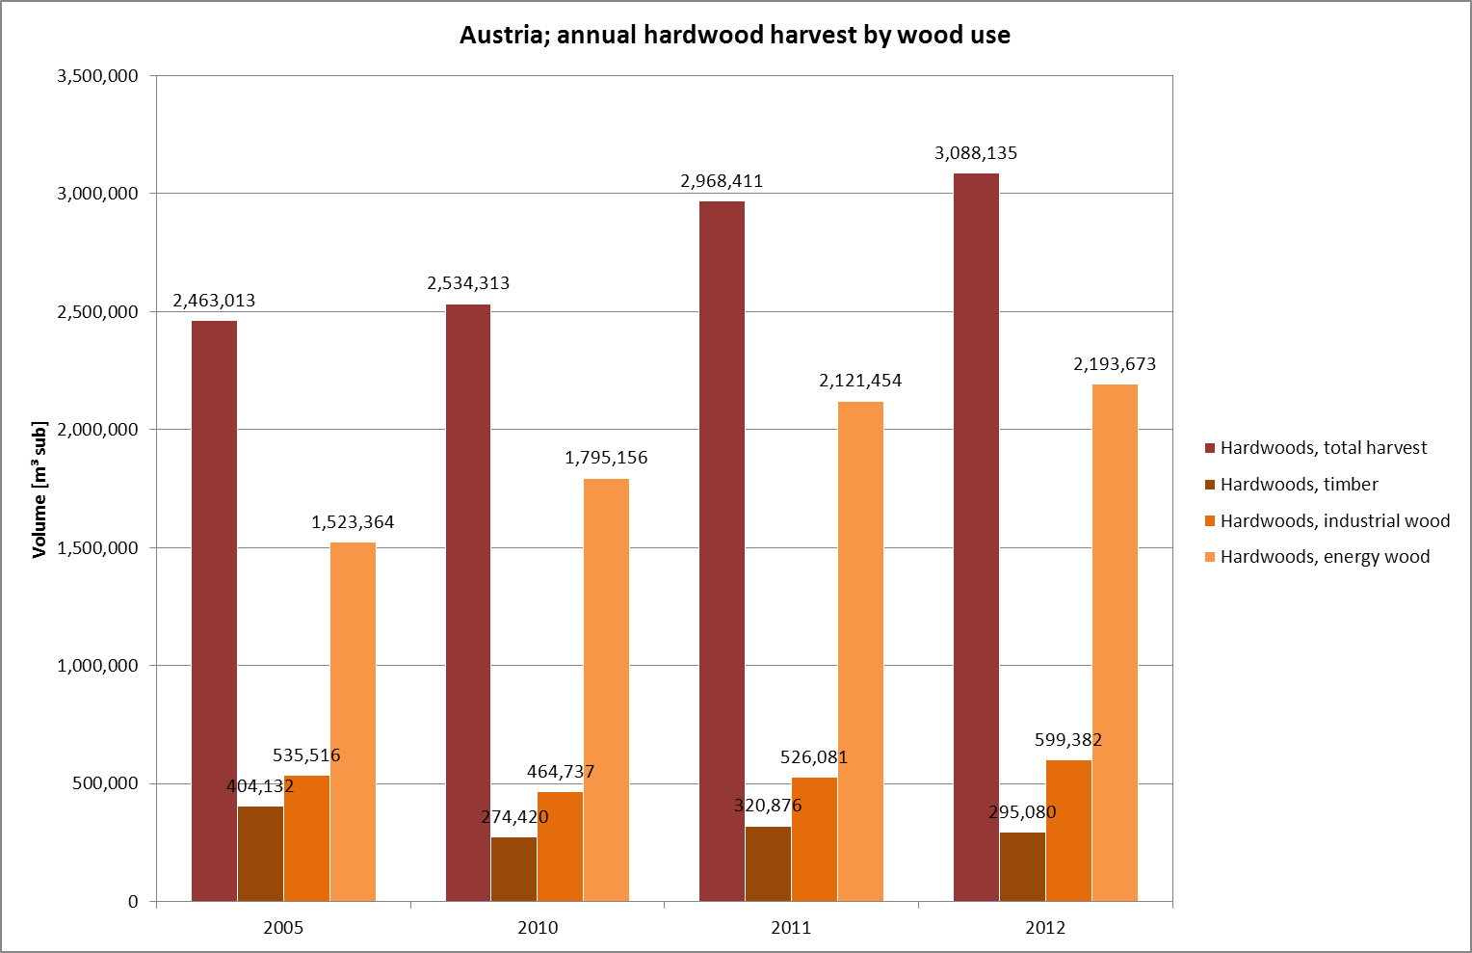
Hardwood resources in Austria

Slide 7
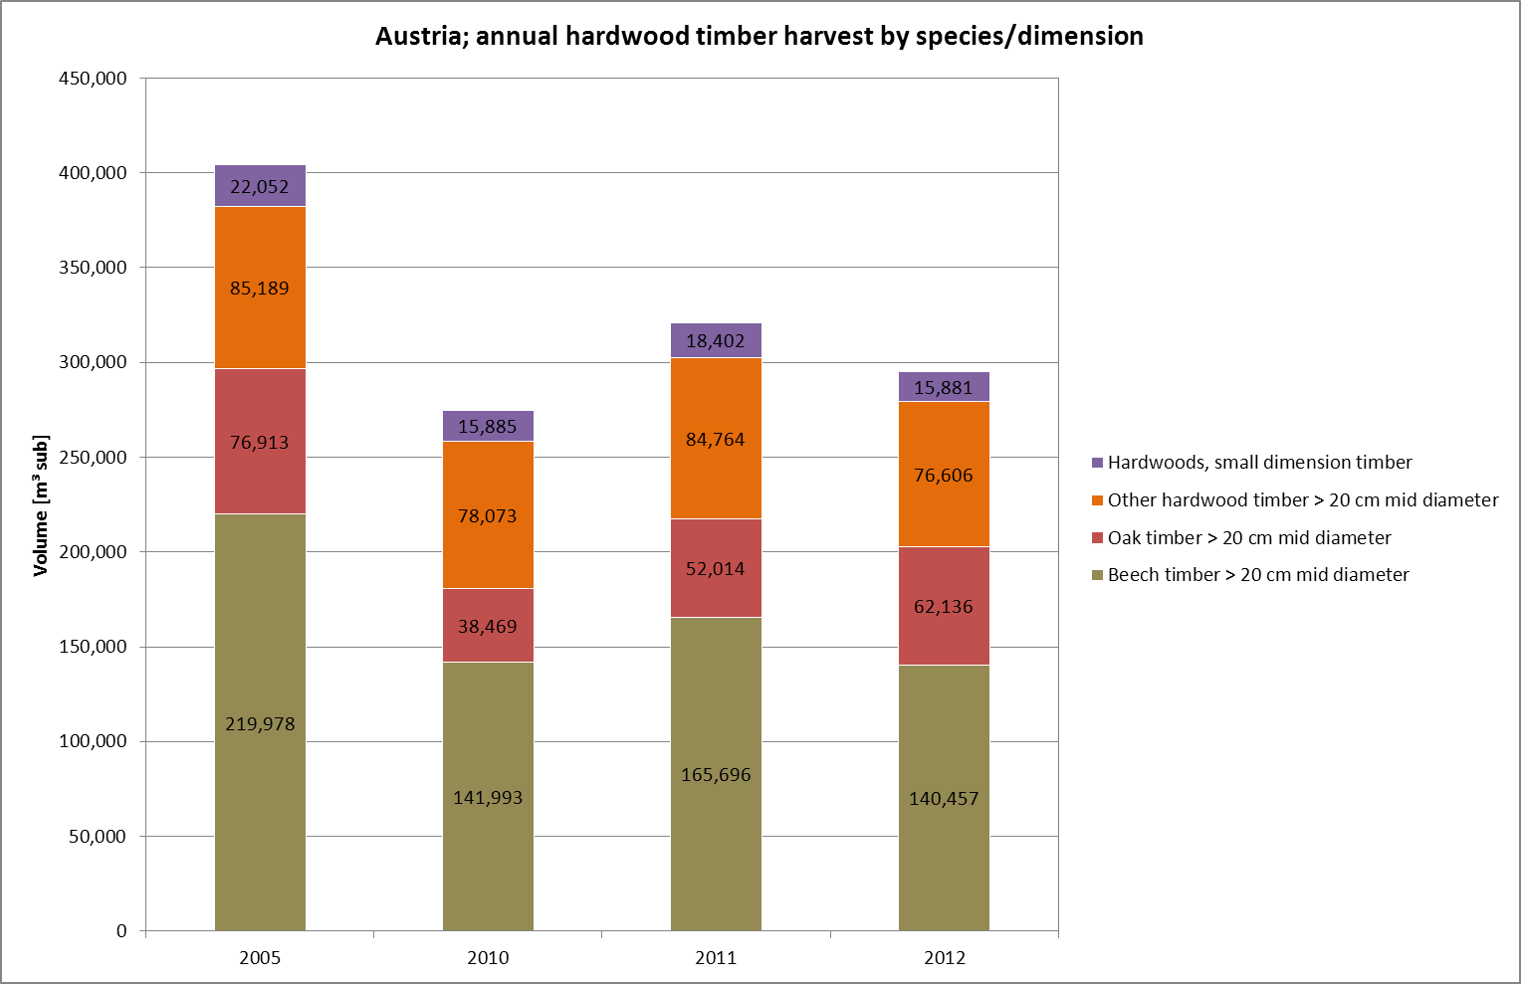
Hardwood resources in Austria

Slide 8
Hardwood resources in France
Standing stocks
Results from the inventory period 2009 – 2013 (inventory campaigns 2009, 2010, 2011, 2012, 2013); data provided by IGN
Standing stock in production forests, living trees
Total standing stock (all trees with DBH ≥ 7.5 cm)
Standing stock of “construction wood” (timber usable for sawing, bois d’œuvre): “sufficiently straight” logs with a minimum top diameter of 20 cm and a minimum length of 2 m
In cubic metres solid over bark (m³ sob)
Standing stock differentiated by species and diameter class, age class, region, forest ownership and “accessibility class” (combination of skidding distance, slope, soil bearing strength, etc.; exploitabilité)
Notes:
IGN: Institut national de l‘information géographique et forestière

Slide 9
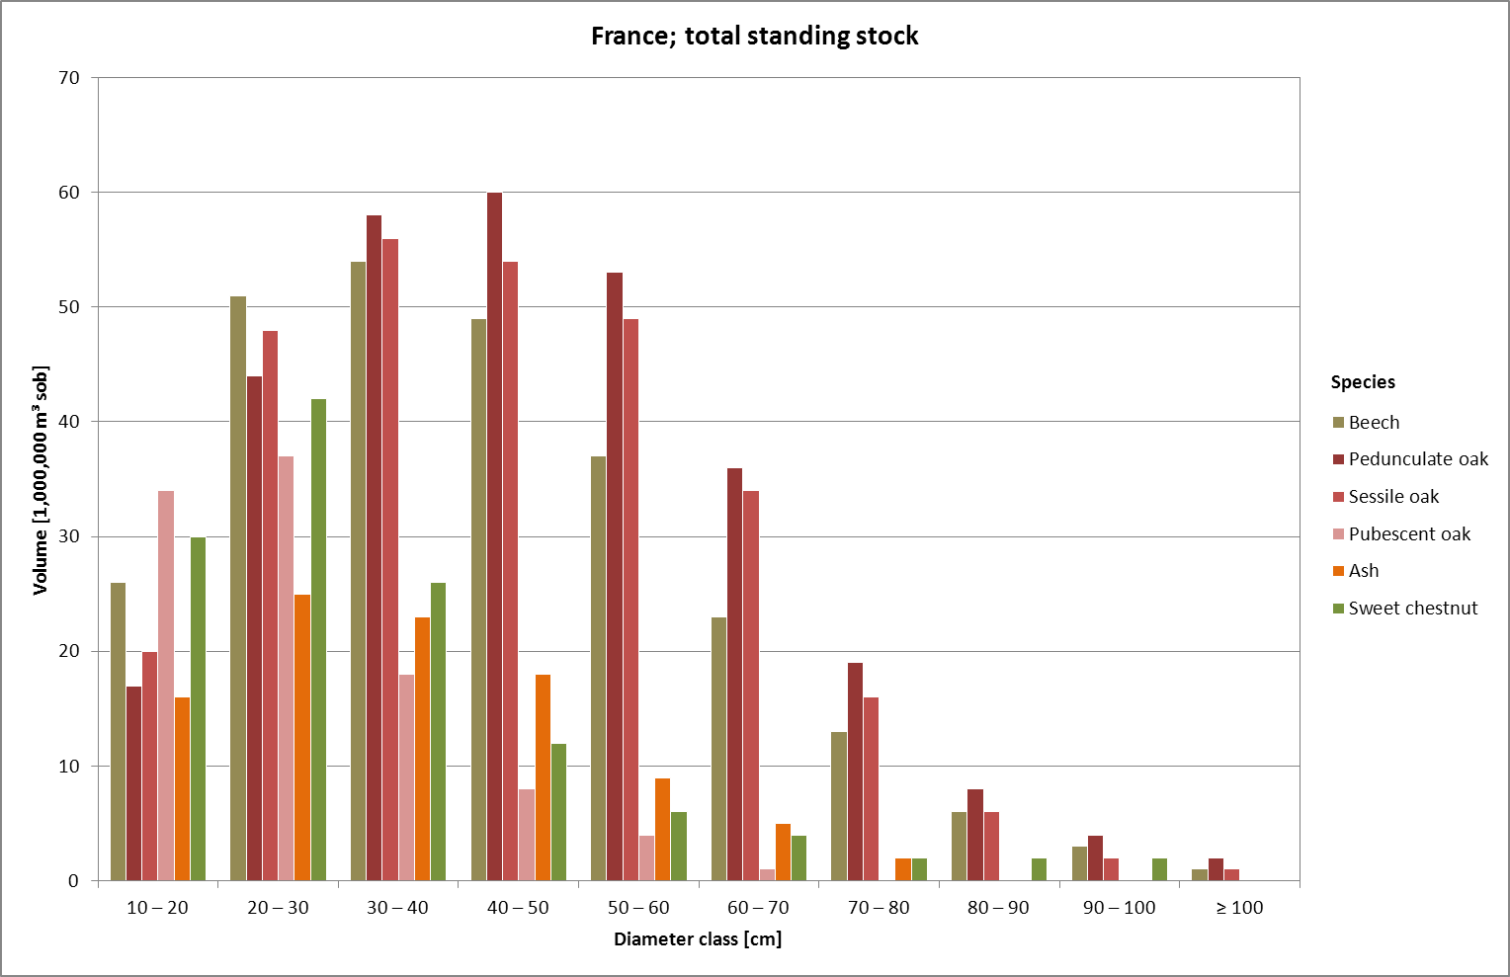
Hardwood resources in France

Slide 10
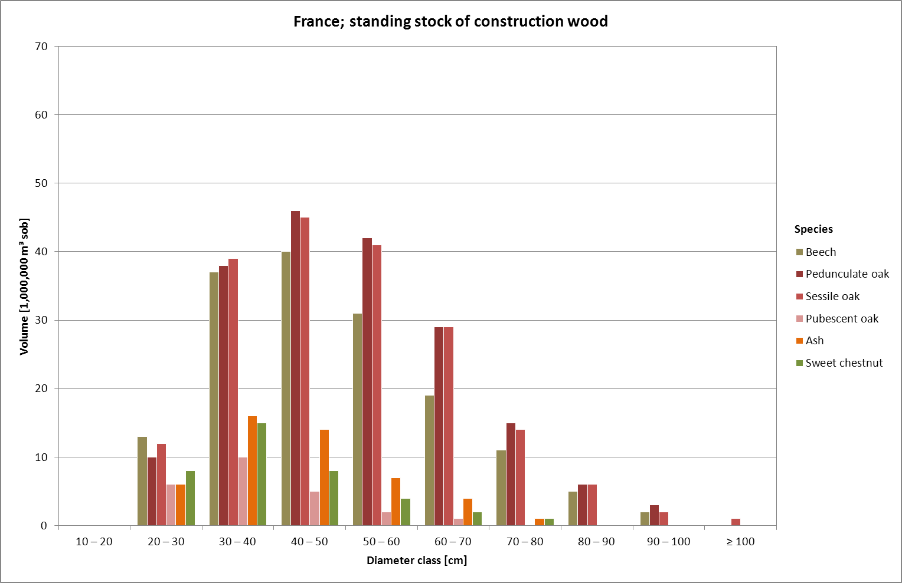
Hardwood resources in France

Slide 11
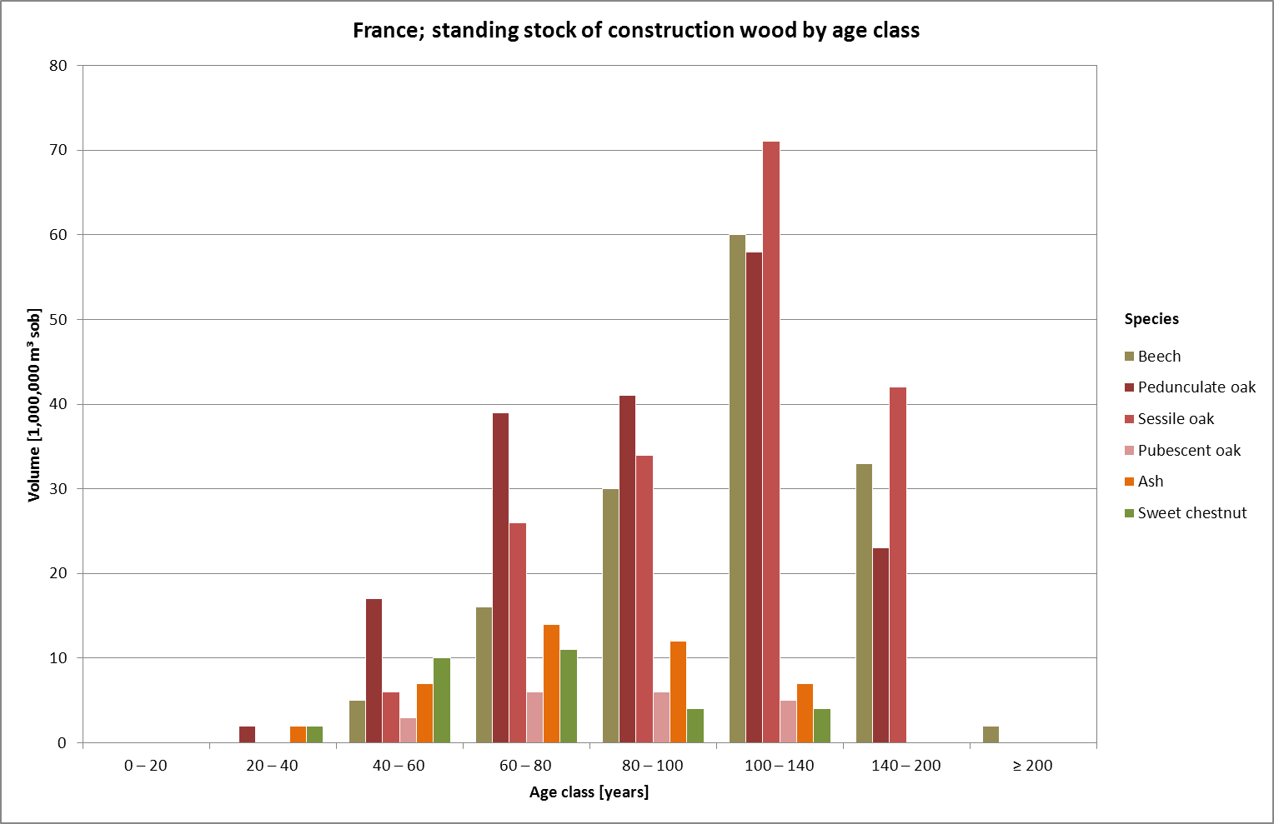
Hardwood resources in France

Slide 12
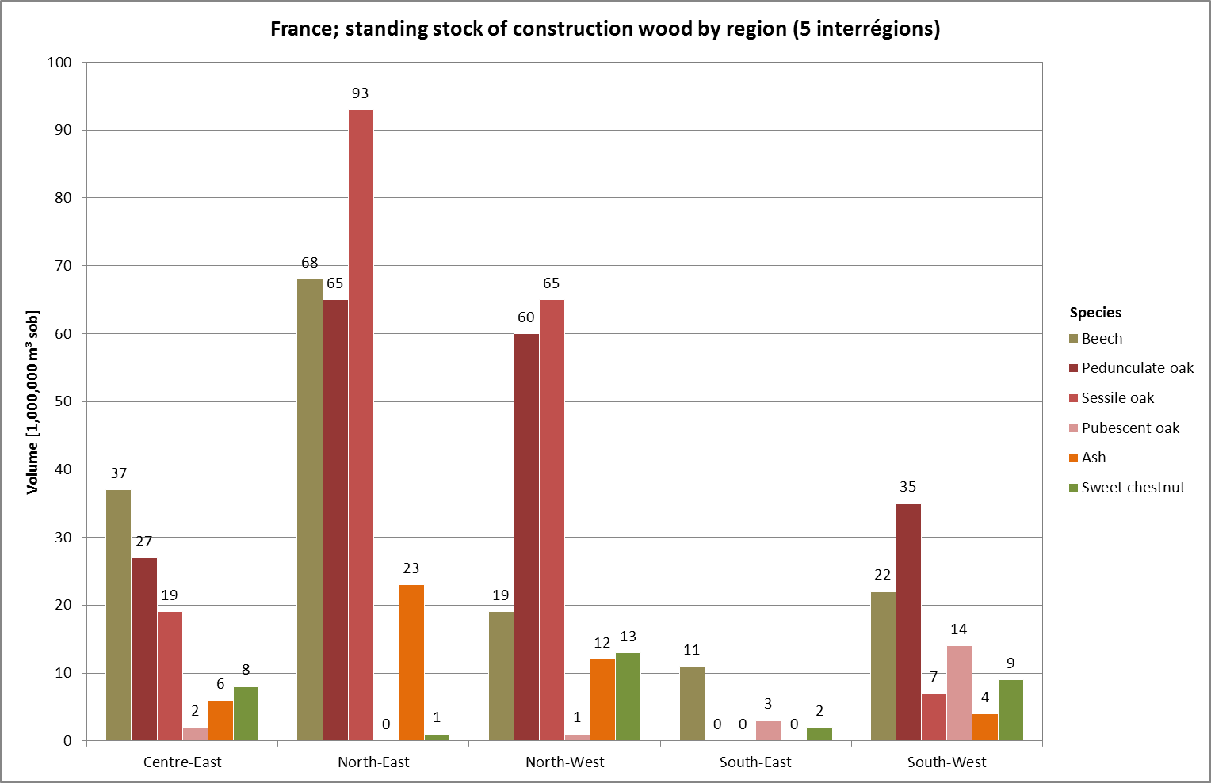
Hardwood resources in France

Slide 13
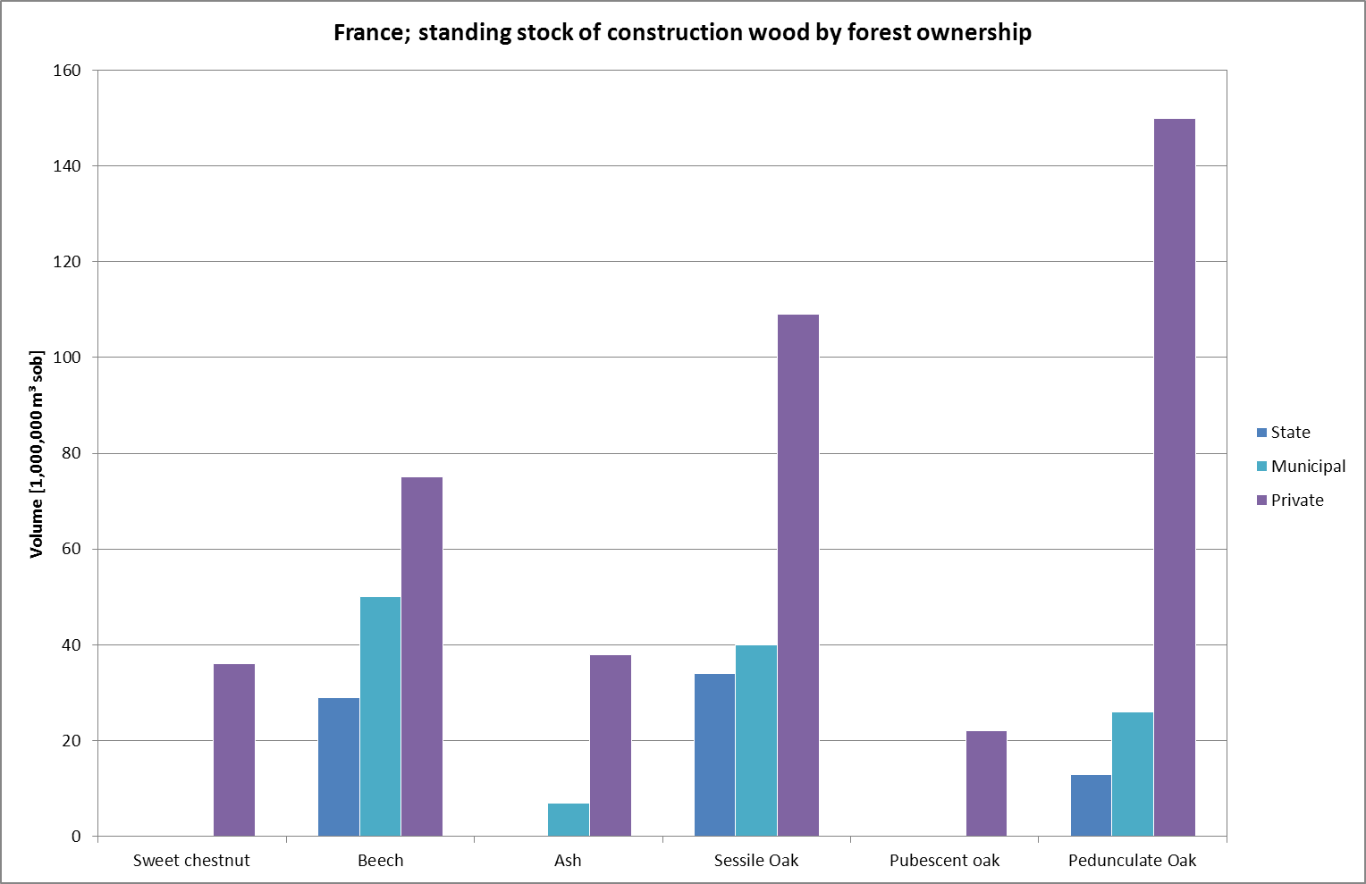
Hardwood resources in France

Slide 14
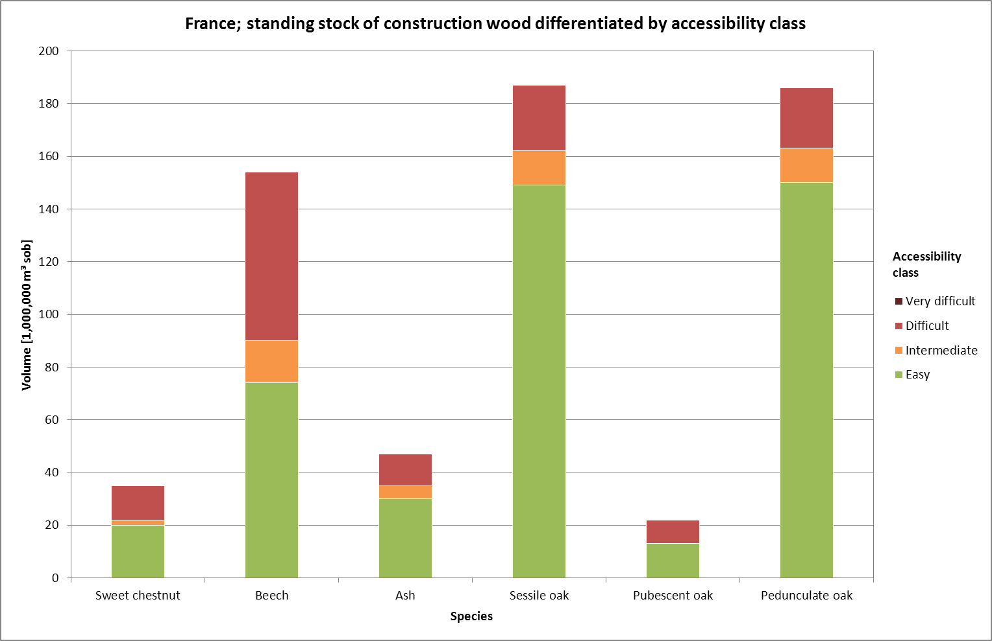
Hardwood resources in France

Slide 15
Hardwood resources in Germany
Standing stocks
Results from the 3rd German national forest inventory (Bundeswaldinventur, BWI) 2012
Total standing stock on the entire forest area, living trees with DBH ≥ 7 cm
Construction wood volumes will be estimated in upcoming WEHAM simulations
In cubic metres solid over bark (m³ sob)
Volumes calculated with the WEHAM model based on the original inventory data: single tree data from variable-size plot sampling
Standing stock differentiated by species and diameter class, age class, federal state and forest ownership
Annual harvest
Data provided by the German ministry of agriculture in the annual report Holzmarkbericht
In cubic metres solid under bark (m³ sub)

Slide 16
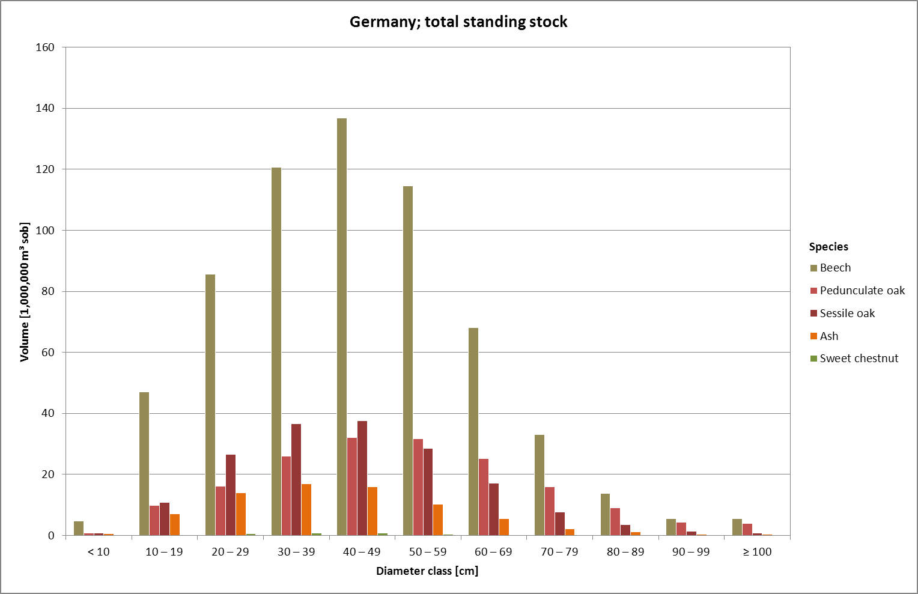
Hardwood resources in Germany

Slide 17
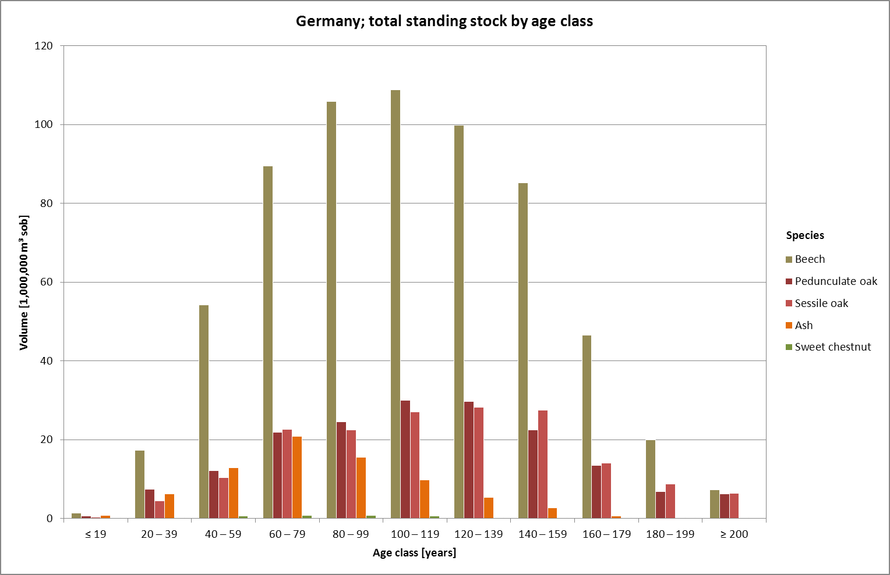
Hardwood resources in Germany

Slide 18
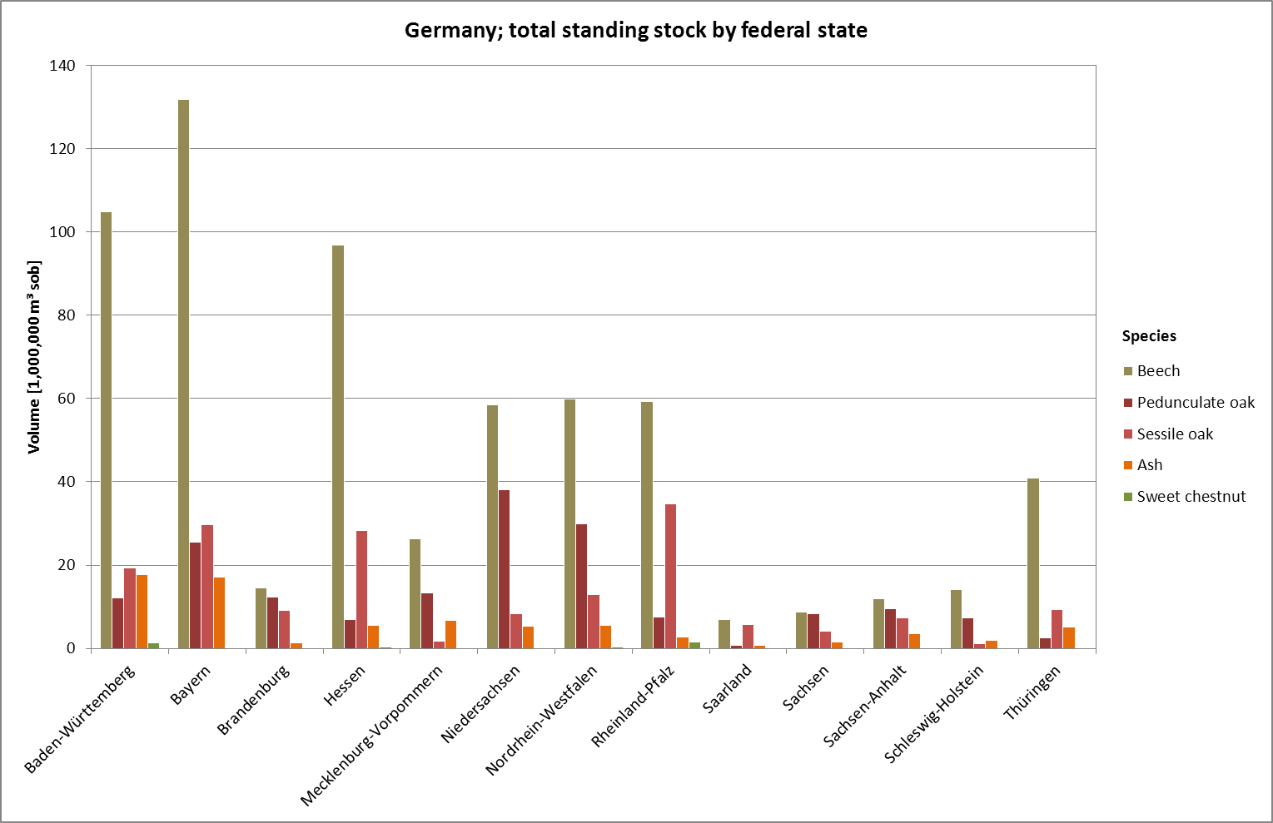
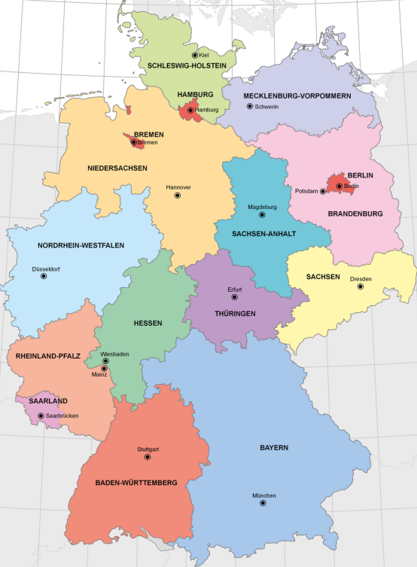
Hardwood resources in Germany

Slide 19
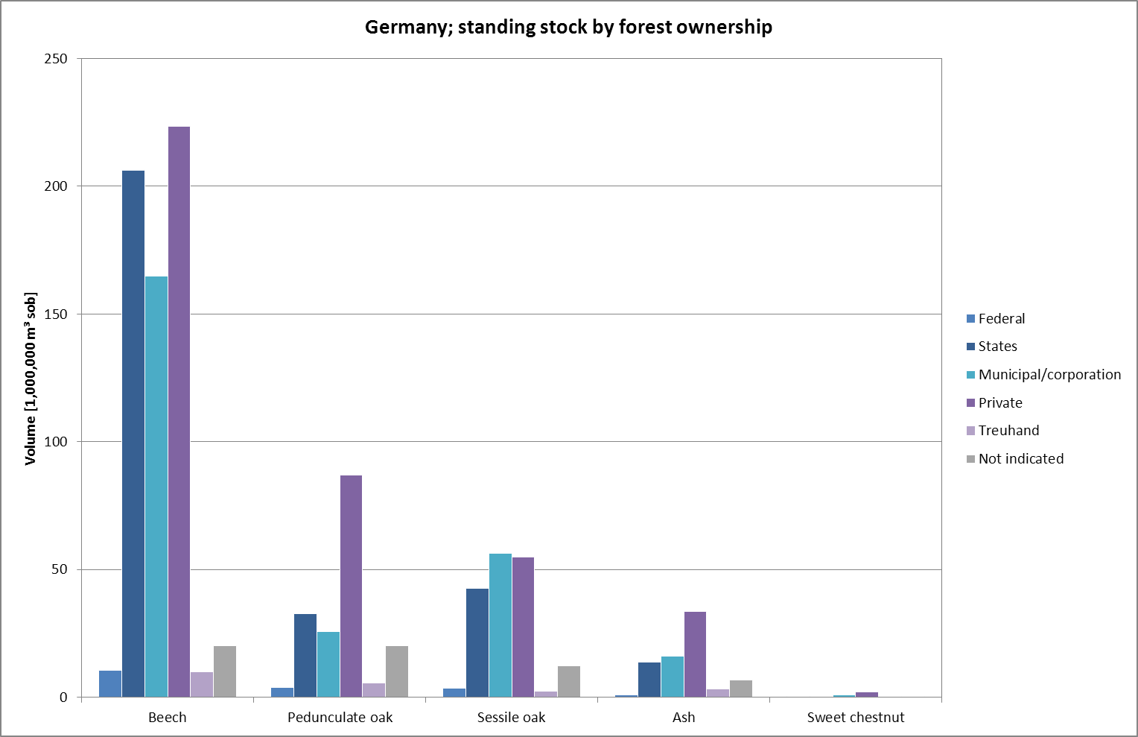
Hardwood resources in Germany

Slide 20
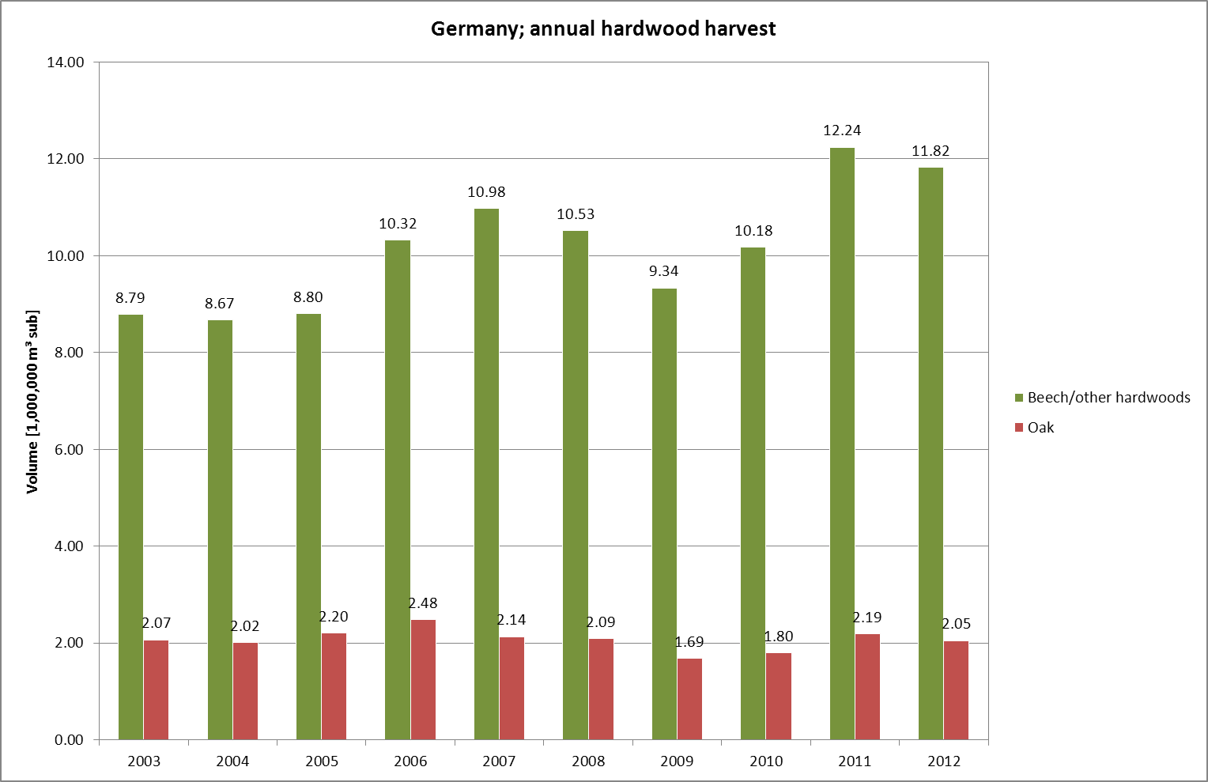
Hardwood resources in Germany

Slide 21
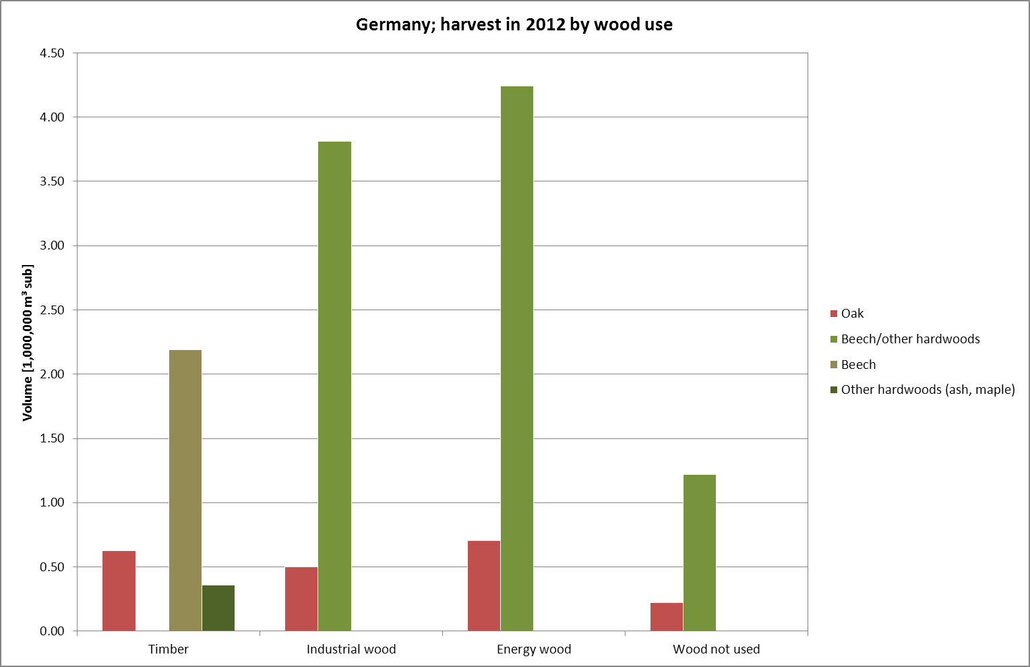
Hardwood resources in Germany

Slide 22
Hardwood resources in Austria, France and Germany – Summary
Standing stocks
Oak has by far the highest share of hardwood standing stock in France (59%), the second highest share in Germany (33%) but only 17% in Austria. Oak has the highest total standing stock of the regarded species in the three countries: ~ 1,063,600,000 m³ (sob)
Beech has the highest share of the hardwood resource in Austria (68%) and Germany (60%) and the second highest share in France (22%). In total, beech has a standing stock of ~ 1,007,100,000 m³ (sob)
Ash has shares between 7% (Germany) and 15% (Austria) → considerably less important than beech and oak. High uncertainty in the prediction of future availability: The rapidly spreading ash dieback disease could cause up to 90% loss of ash standing stock in some regions within the next decade
Sweet chestnut: considerable standing stock in France (11%), only very small stocks in Austria and Germany. Estimates for Austria and Germany, especially diameter distribution, have a rather high standard error (± 20% in the case of Austria)

Slide 23
Hardwood resources in Austria, France and Germany – Summary
Reported harvests
Austria: Energy wood has a very high share of the annual hardwood harvest (62–72%); beech has the highest share of the annual timber harvest (48–54%)
Germany: Beech has the highest share of timber harvest (2012: 69%); the share of energy wood is much lower than in Austria (2012: 36%)
Reported figures on annual harvest can only be seen as a (rather coarse) estimate; especially harvested volumes from small private forest properties are often estimated

Slide 24
Hardwood resources in Austria, France and Germany – Summary
Open questions
No inventory data for Slovenia have been received yet → Data available?
For France and Slovenia, data on hardwood harvests/uses still have to be investigated → Data available?
Do we want to have a detailed analysis of the flows of the harvested volumes (uses/industries)? → Such data is probably only available for state forests (e.g. in Baden-Württemberg) and not readily accessible
Detailed survey of roundwood prices required or beyond the scope of our resource estimations? → Large regional, temporal and individual fluctuations

Slide 25
Forecast to future resource availability (WP1.2)

Slide 26
Forecast of hardwood resources in Germany
Simulation of forest growth and silvicultural treatment (thinnings, regeneration fellings, etc.) on the basis of the most recent inventory data (BWI data)
Simulation scenarios for the official WEHAM prognosis are not yet definitely specified by the state forest authorities → Forecasts in the scope of EU Hardwoods will be based on these scenarios
If feasible: definition of “lower” and “upper” scenarios: reduced harvests vs. increased harvests
Second component of WEHAM: sorting simulation → Testing of different sorting/bucking scenarios possible
Limitation: The roundwood quality of the hardwood resource cannot be predicted → No information about roundwood quality included in the inventory data yet.

Slide 27
Log quality and roundwood allocation potential (WP1.3)

Slide 28
WP1.3: Log quality and roundwood allocation potential
Current state
Sample material of three species has been acquired: 30 beech logs, 18 oak logs and 16 chestnut logs
The logs will arrive at FVA in January 2015; quality sorting, CT scanning and MOE testing will be performed successively
Upcoming tasks
Sample logs of ash will be acquired; measurements will be performed
Testing of feature extraction software for CT images (developed for softwoods) on the hardwood species; adaptation if feasible
Open questions
Sawing simulations with virtual logs generated from the CT images feasible? → Estimation of optimization potential possible
Lamellas from the sample logs to be strength tested at HFA?
Notes:
- One open question is whether testing of lamellas from the sample logs could be strength tested at HFA i.e. would fit in their testing plan

Slide 29
Thank you for your attention!

