Slide 1
European Hardwoods for the Building Sector (EU Hardwoods)
Project meeting
2016/06/02–03 / Univerza v Ljubljani
WP 1: Hardwood resources in Europe
Resource forecasts for Austria and France
Characterization of hardwood timber
Lorenz Breinig

Slide 2
Topics
Resource forecasts for Austria
Resource forecasts for France
Characterization of hardwood timber: Results for chestnut and oak
Other recent activities
Next steps

Slide 3
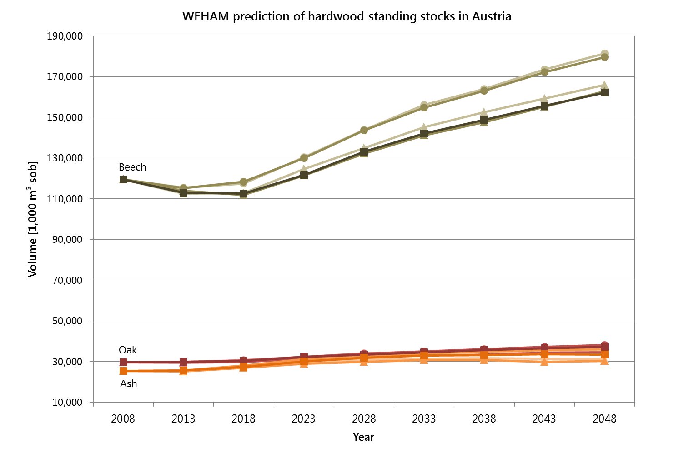
Resource forecasts for Austria: Overestimation of growth and fellings
36% increase
25% increase
Notes:
Beech: increase of 36% vs. 6% with German data
Oak: 1% increase with German data

Slide 4
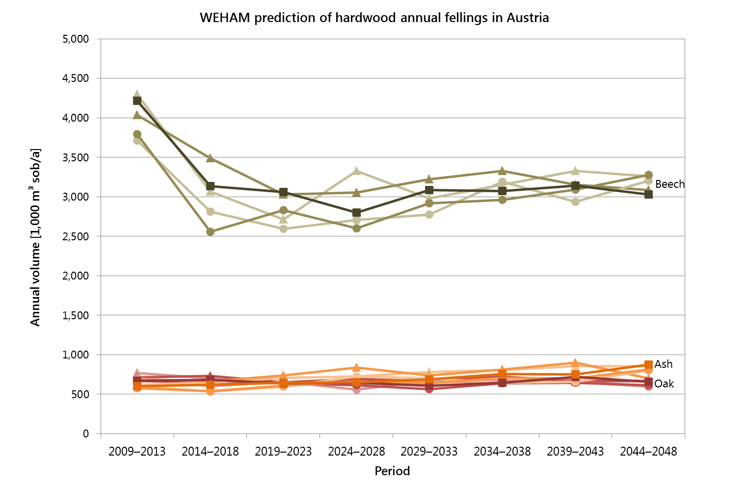
Resource forecasts for Austria: Overestimation of growth and fellings
2025: 2.8 M m³/a
+ 60%
ÖWI: 1.8 M m³/a
Oak, 2025: 0.64 M m³/a
Oak, ÖWI: 0.56 M m³/ a
Difference: 14%

Slide 5
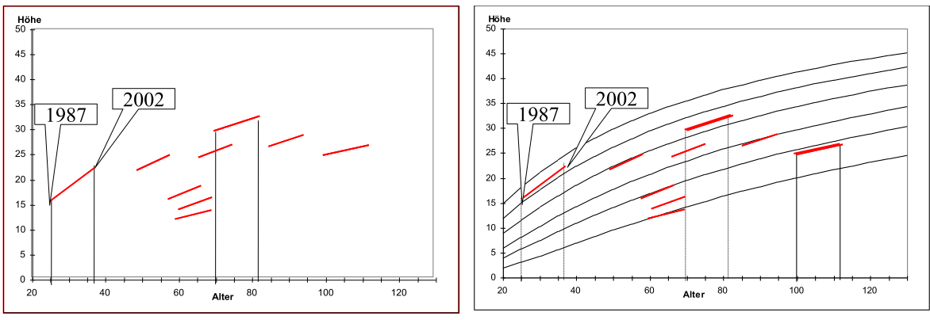
Resource forecasts for Austria: Overestimation of growth and fellings
Approach:
Re-parameterization of growth models in WEHAM with repeated inventory data for beech and oak (Data from ÖWI 2007–09 and preceeding inventory provided by BFW)
Repetition of simulations

Slide 6
Resource forecasts for France: Study by IGN/FCBA
First study on potential roundwood availability covering the entire forest area in France: Disponibilités forestières pour l’energie et les matériaux à l’horizon 2035; on request by the French environment agency
Data basis: Inventory 2009–2013
Models of growth/mortality and silviculture yield gross annual availability (comparable to the annual fellings in WEHAM)
Applying volume reductions due to technical/economical restrictions leads to “usable annual availability”
Two scenarios:
constant management: maintaining mean felling rates observed between the last two inventories for the distinguished forest type units (strata)
“dynamic management”: progressively applying the highest observed felling rate to the entire stratum

Slide 7
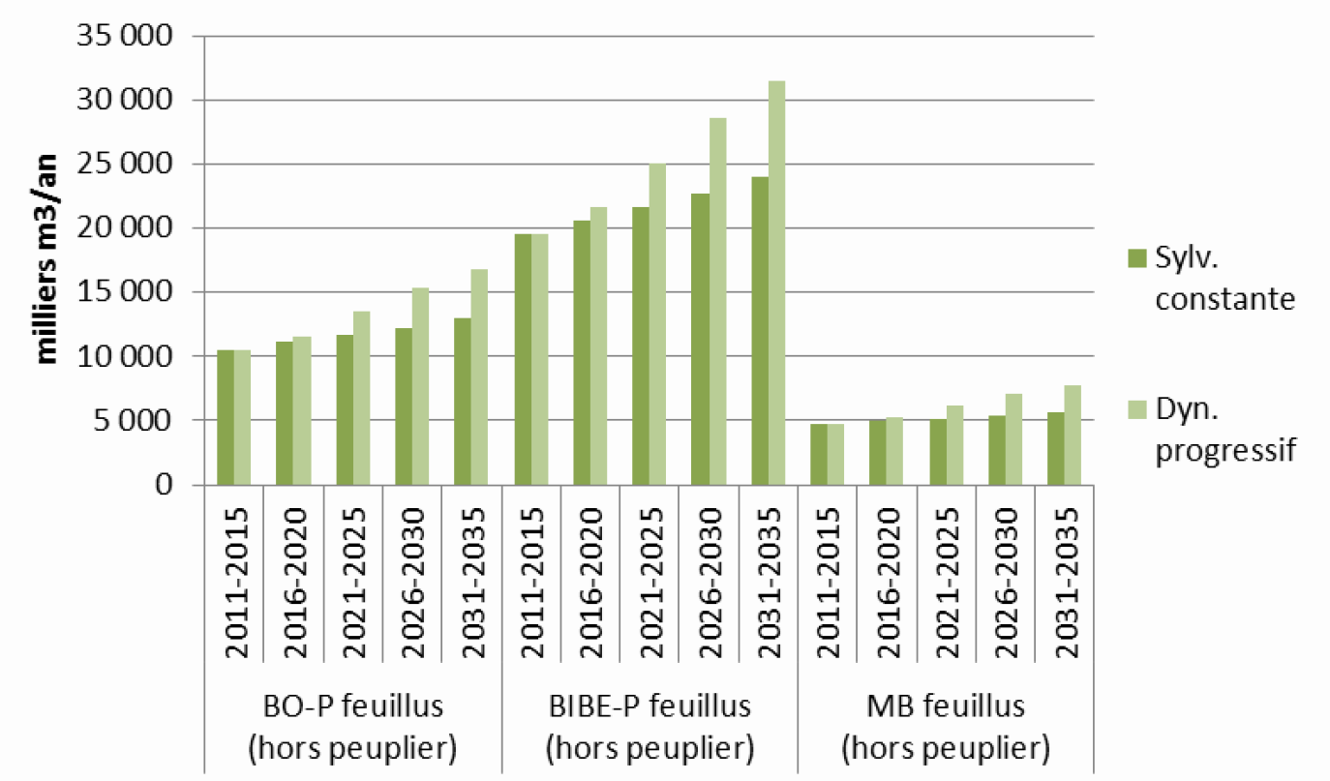
Resource forecasts for France: Study by IGN/FCBA
Gross annual availability of hardwood timber (all species combined):
increase from 10.6 to 13.0 M m³/a in the constant management scenario
increase from 10.6 to 16.8 M m³/a in the “dynamic management” scenario
Notes:
WEHAM-Simulation (Basisszenario): Jährliche Einschlagsmengen in D, 2023–2027
Buche: 13.5 M m³
Eiche: 7.1 M m³
Esche: 1.9 M m³
(aber alle Sortimente, d.h. Stamm- und Industrie-/Energieholz, und inkl. Ernteverlusten, etc.)
Stammholzaufkommen in D (WEHAM-Sort), 2023–2027
Buche: 6.4 M m³
Eiche: 2.9 M m³
Esche: 0.7 M m³

Slide 8
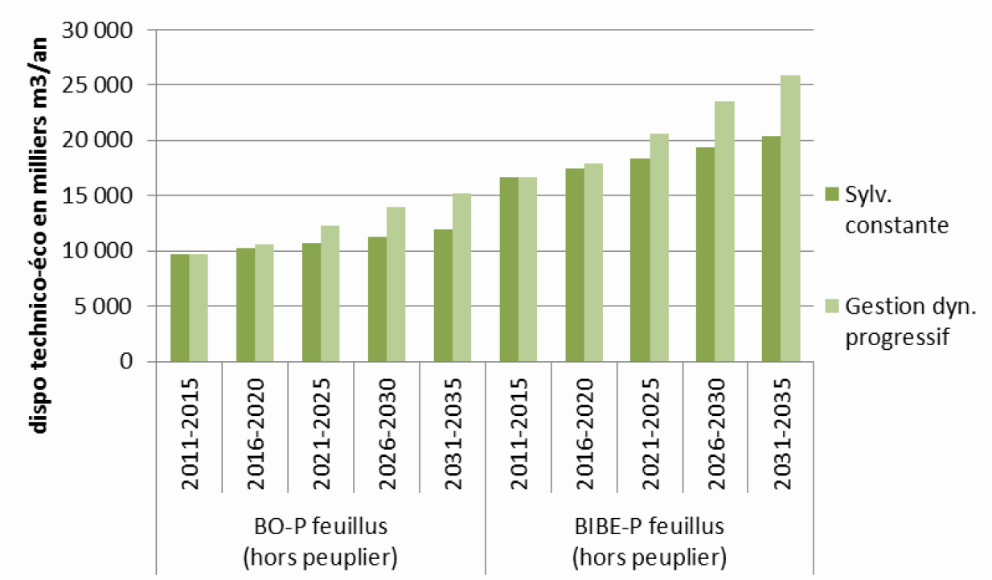
Resource forecasts for France: Study by IGN/FCBA
Usable annual availability of hardwood timber (all species combined):
increase from 9.7 to 11.9 M m³/a in the constant management scenario
increase from 9.7 to 15.2 M m³/a in the “dynamic management” scenario

Slide 9
Characterization of hardwood timber: Results for chestnut and oak
Chestnut: Board values (N = 97)
Property | Min | Max | Mean | StDev | CV
Moisture content [%] | 43 | 83 | 59 | 8 | 13%
Density [kg/m³] | 667 | 947 | 812 | 58 | 7%
MOE_{dyn} [kN/mm²] | 8.3 | 15.7 | 11.7 | 1.7 | 14%
Oak: Board values (N = 85)
Property | Min | Max | Mean | StDev | CV
Moisture content [%] | 29 | 69 | 54 | 7 | 14%
Density [kg/m³] | 731 | 1029 | 915 | 59 | 6%
MOE_{dyn} [kN/mm²] | 7.4 | 16.2 | 12.5 | 1.7 | 13%

Slide 10
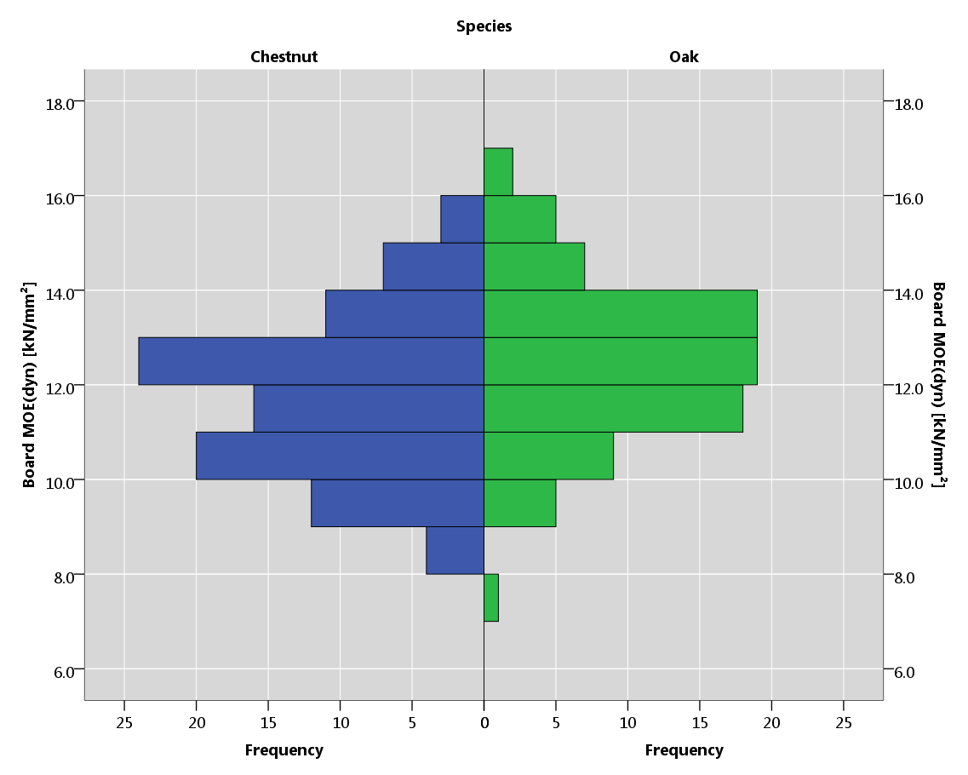
Characterization of hardwood timber: Results for chestnut and oak
Frequency distribution of board MOE_{dyn} of chestnut and oak
2%
3%
6%
7%
8%
11%
22%
25%
22%
16%
21%
21%
11%
12%
6%
4%
1%

Slide 11
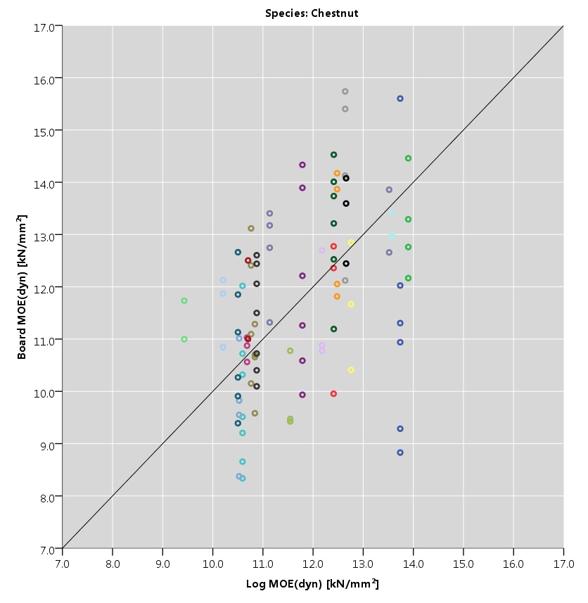
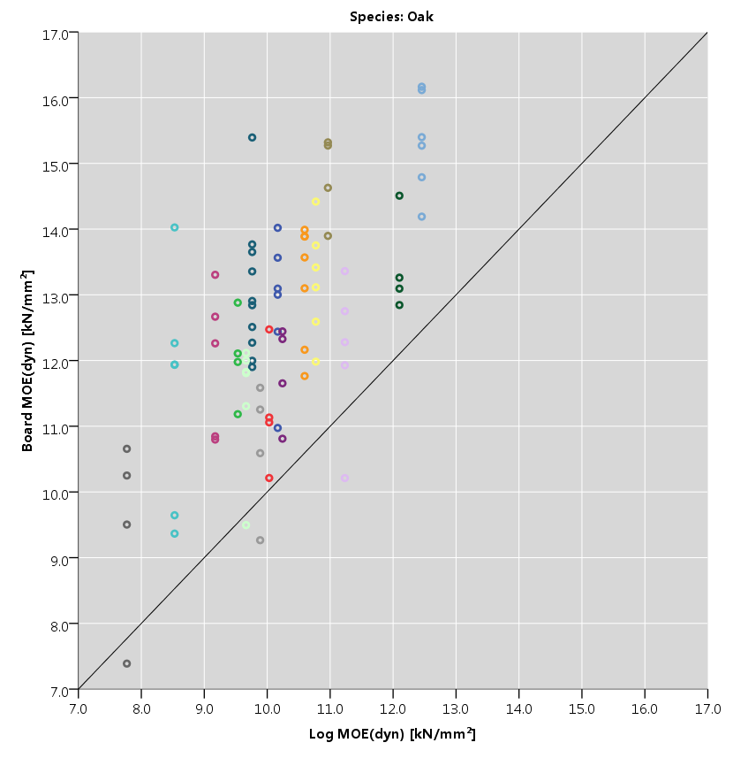
Characterization of hardwood timber: Results for chestnut and oak
Board MOE_{dyn} vs. log MOE_{dyn} for chestnut and oak

Slide 12
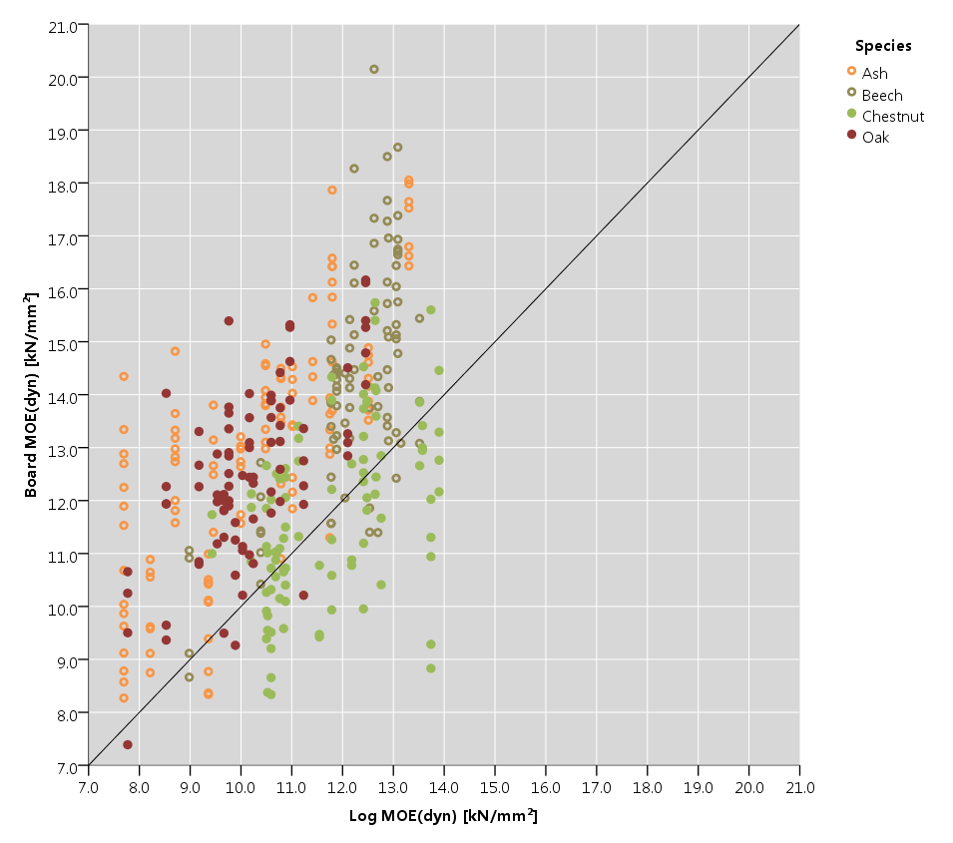
Characterization of hardwood timber
Board MOE_{dyn} vs. log MOE_{dyn} for all tested species
Notes:
Normalverteilung Board MOE_{dyn}
alle (N=384): ja; P = 0.18 (K-S), 0.13 (Shapiro-Wilk)
ash (N=116): grenzwertig; P = 0.06 (K-S), 0.04 (Shapiro-Wilk)
beech (N=86): ja; P = 0.2 (K-S), 0.91 (Shapiro-Wilk)
chestnut (N=97): ja; P = 0.2 (K-S), 0.53 (Shapiro-Wilk)
oak (N=85): ja; P = 0.2 (K-S), 0.71 (Shapiro-Wilk)
ANOVA: Unterschiede zwischen Stämmen
ash: ***, P 0.00
beech: ***, P 0.00
chestnut: ***, P 0.00
oak: ***, P 0.00

Slide 13
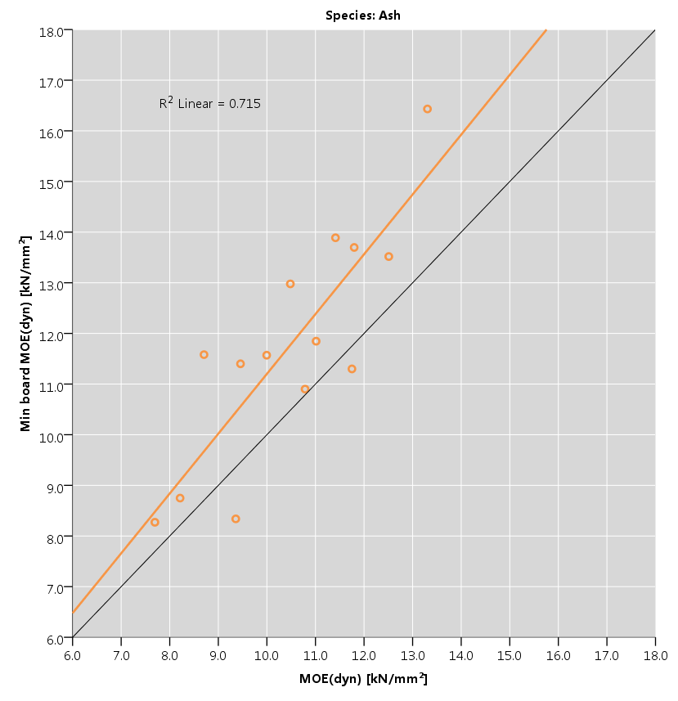
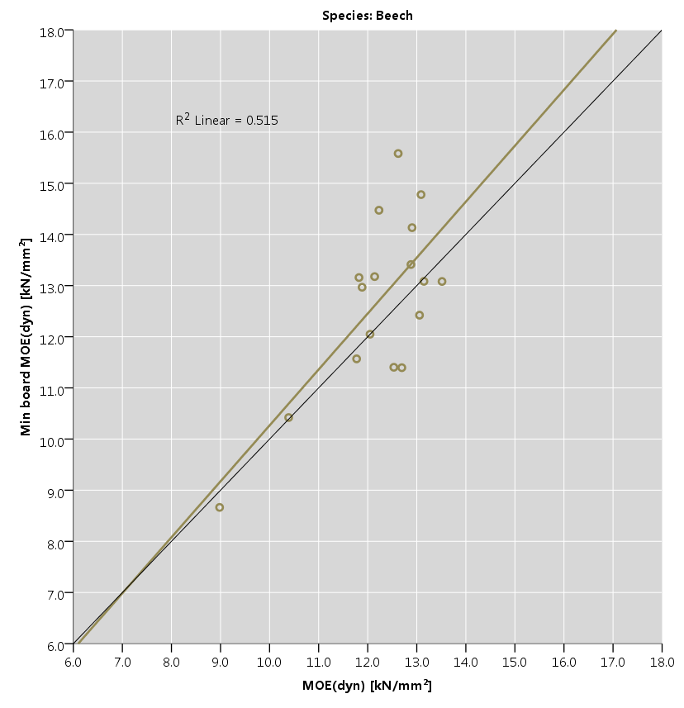
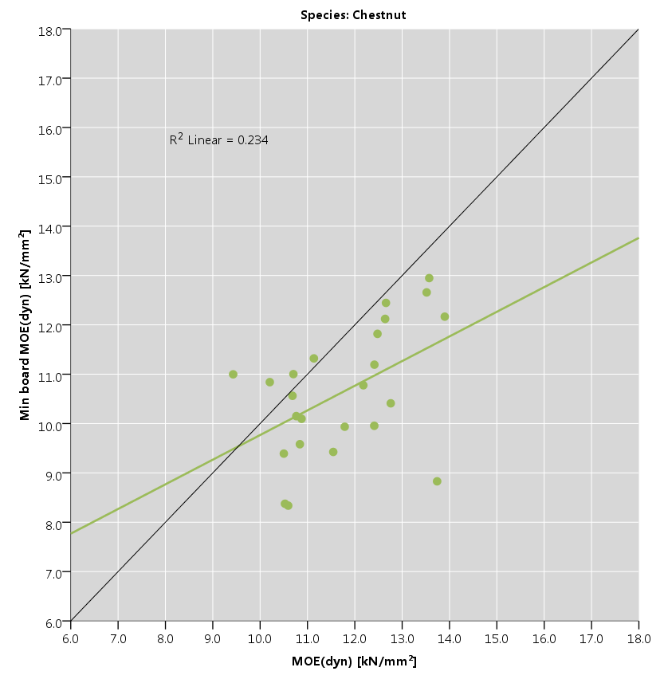
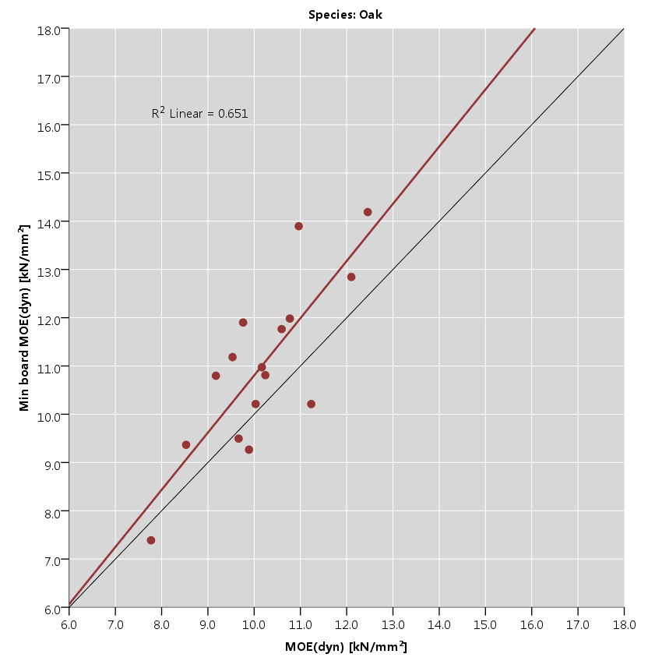
Min board MOE_{dyn} vs. log MOE_{dyn} for all tested species
Characterization of hardwood timber

Slide 14
Other recent activities
Manual marking of knots in the CT images of the ash, chestnut and oak logs

Slide 15
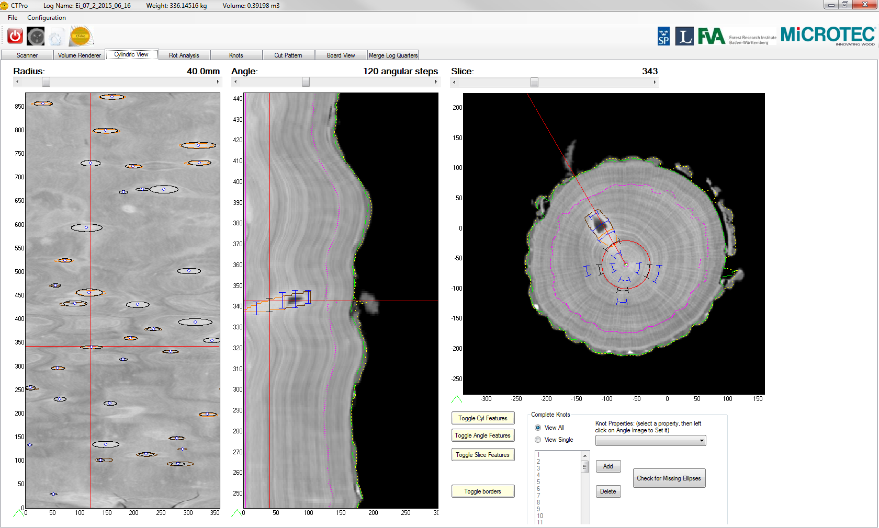
Other recent activities
Manual marking of knots in the CT images of the ash, chestnut and oak logs

Slide 16
Other recent activities
Manual marking of knots in the CT images of the ash, chestnut and oak logs
Report on national and EU log grading principles (Milestone 8) completed in draft version

Slide 17
Next steps
Strength testing of the oak and chestnut boards at HFA
Publications:
Article about measurements/strength testing on ash and beech
Further publications?

Slide 18
Thank you for your attention!

Slide 19
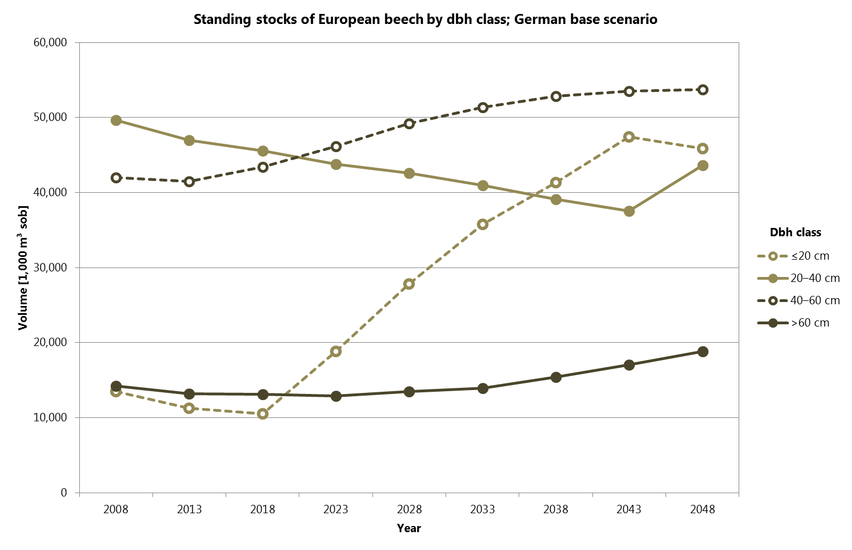
Resource forecasts for Austria: Overestimation of growth and fellings

Slide 20
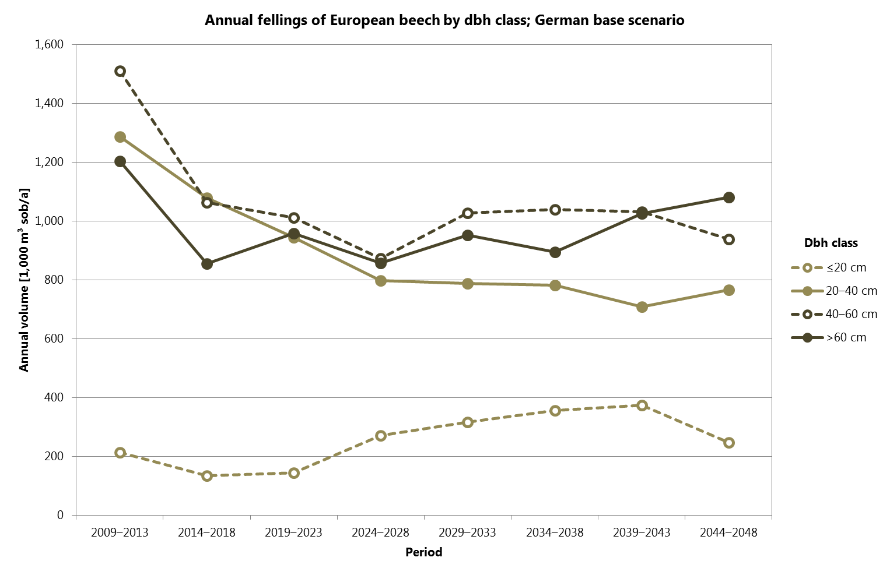
Resource forecasts for Austria: Overestimation of growth and fellings

Slide 21
Characterization of hardwood timber
Ash: Board values (N = 116)
Property | Min | Max | Mean | StDev | CV
Moisture content [%] | 21 | 29 | 24 | 2 | 8%
Density [kg/m³] | 567 | 863 | 693 | 55 | 8%
MOE_{dyn} [kN/mm²] | 8.3 | 18.1 | 13.0 | 2.3 | 18%
Beech: Board values (N = 86)
Property | Min | Max | Mean | StDev | CV
Moisture content [%] | 18 | 26 | 21 | 2 | 10%
Density [kg/m³] | 664 | 835 | 726 | 34 | 5%
MOE_{dyn} [kN/mm²] | 8.7 | 20.2 | 14.3 | 2.2 | 15%

Slide 22
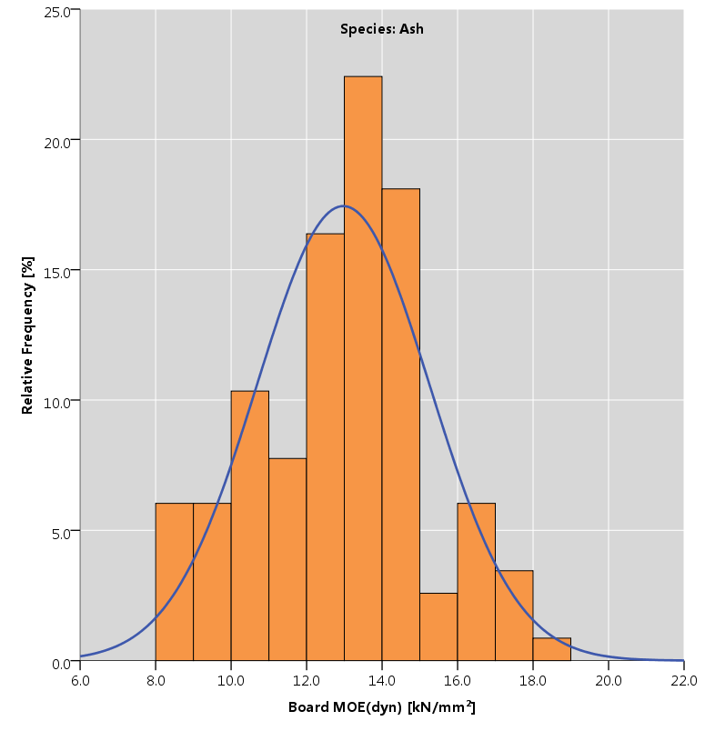
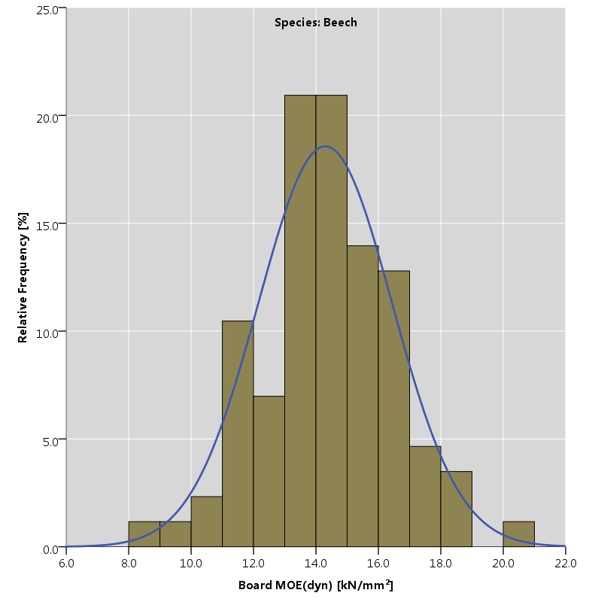
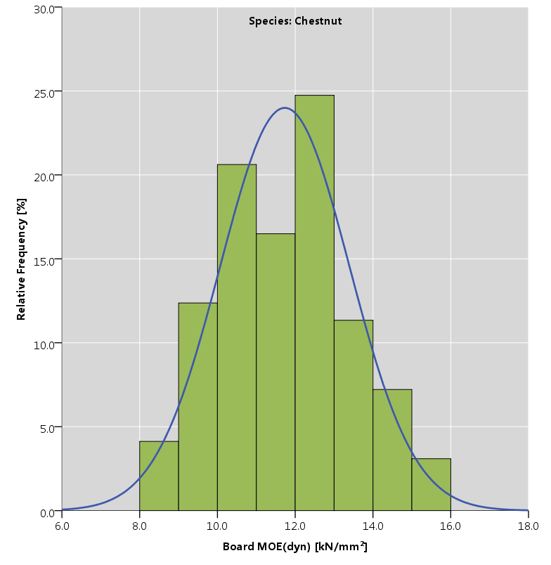
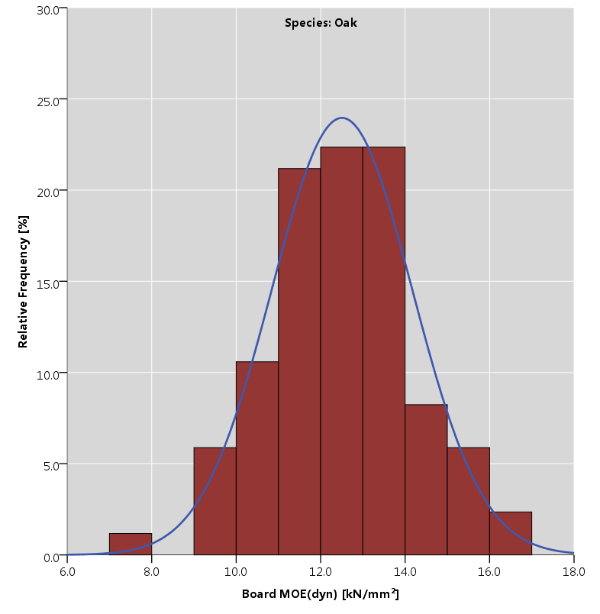
Frequency distributions of board MOE_{dyn} of the tested species
Characterization of hardwood timber

Slide 23
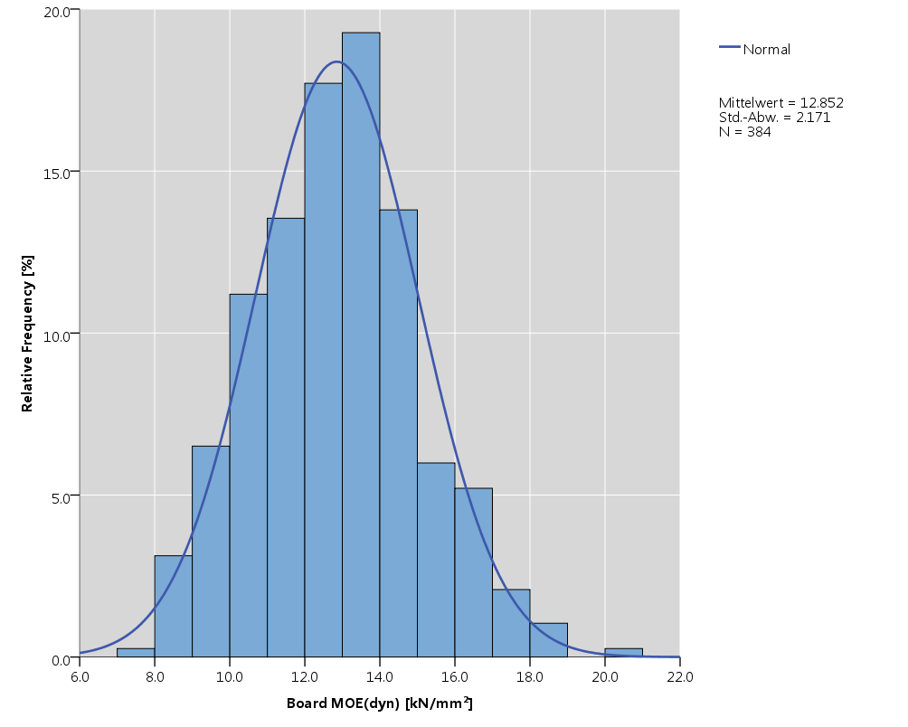
Frequency distribution of board MOE_{dyn}, data of all species combined
Characterization of hardwood timber

Slide 24
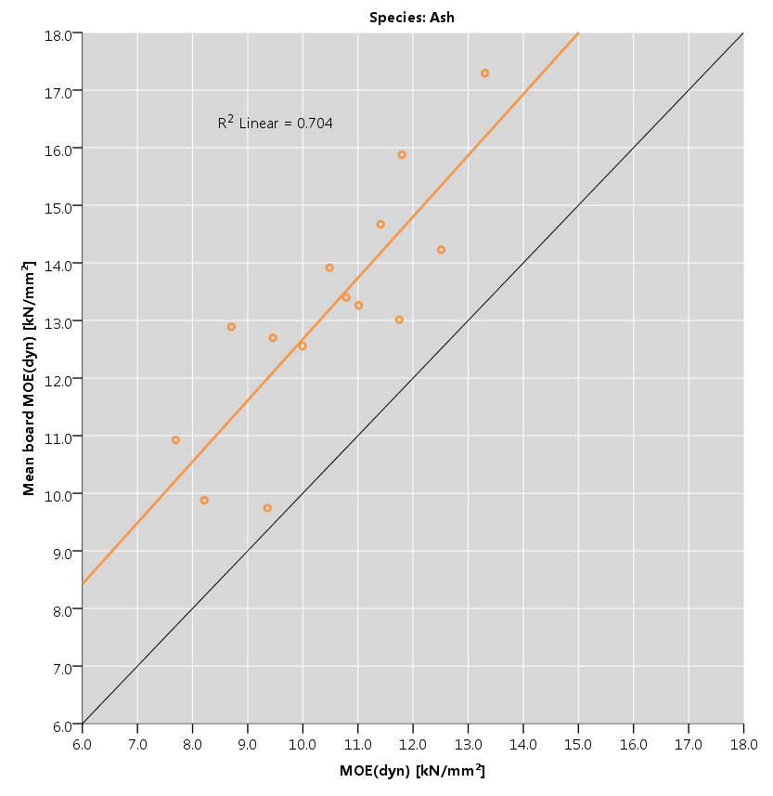
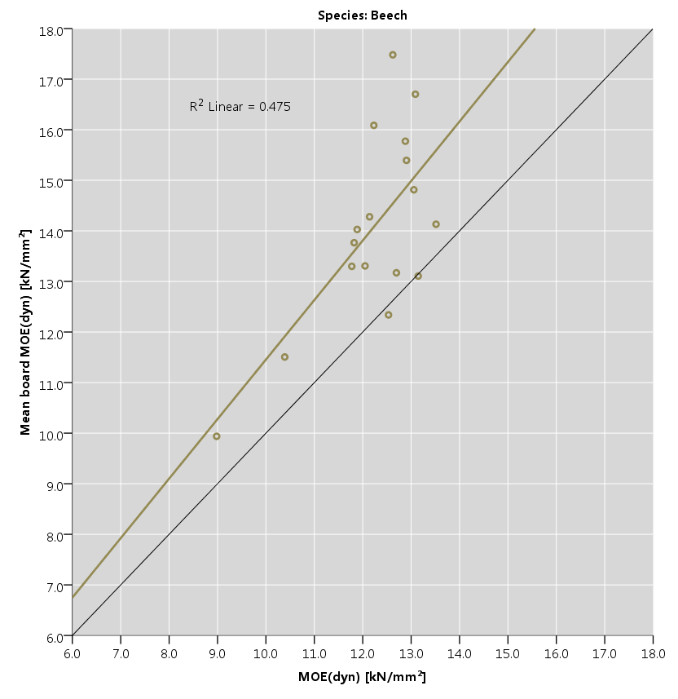
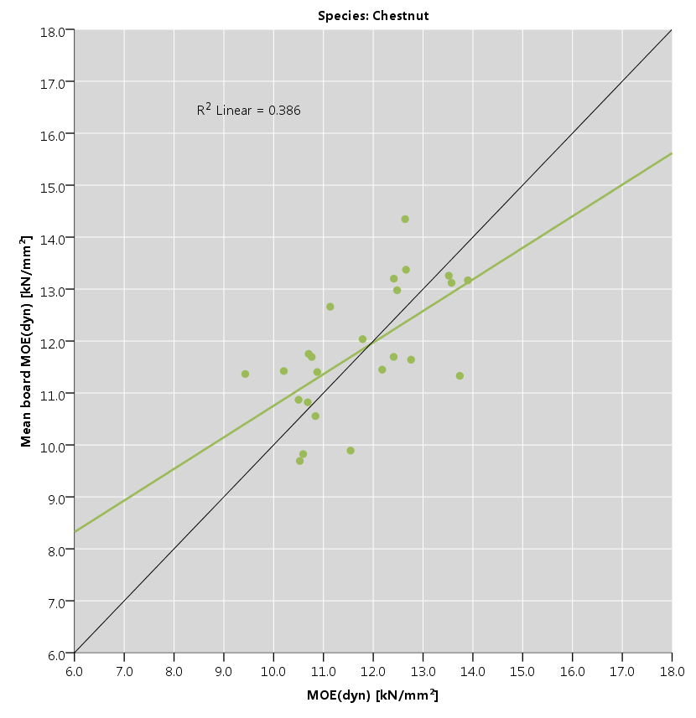
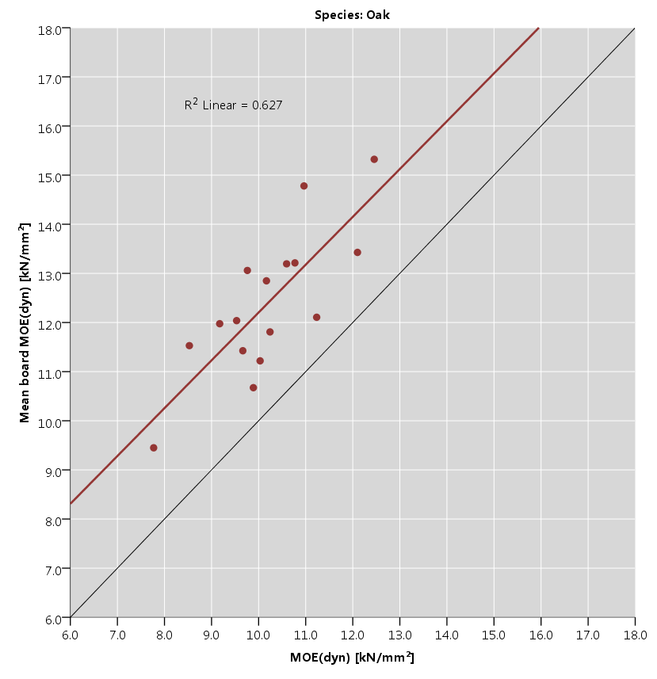
Mean board MOE_{dyn} vs. log MOE_{dyn} for all tested species
Characterization of hardwood timber

Slide 25
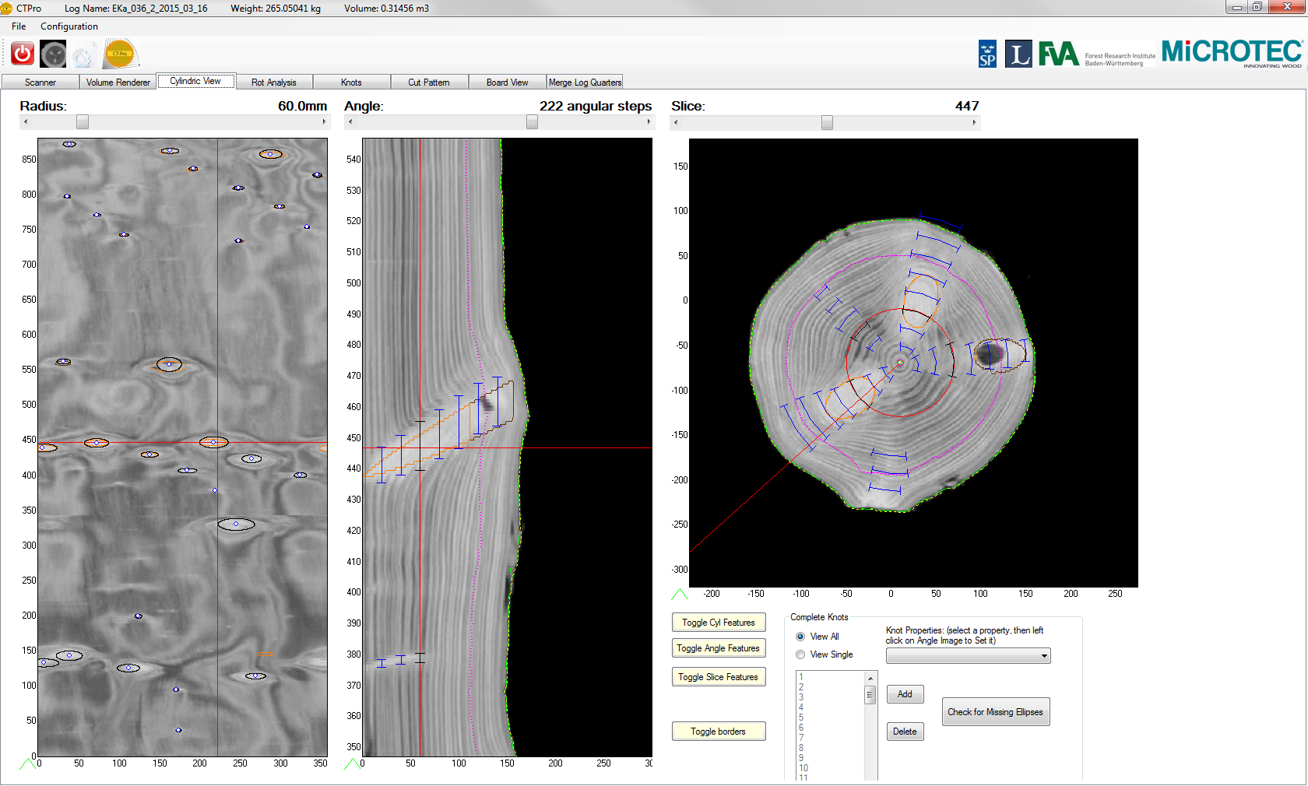
Other recent activities
Manual marking of knots in the CT images of the ash, chestnut and oak logs

Slide 26
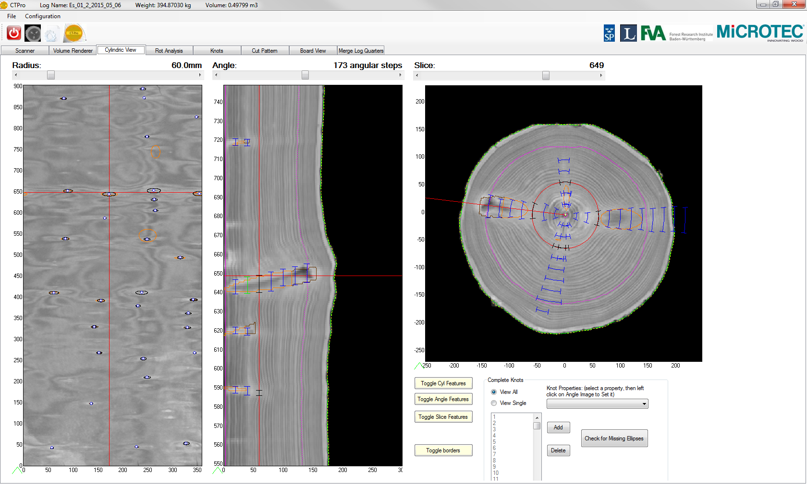
Other recent activities
Manual marking of knots in the CT images of the ash, chestnut and oak logs

