Slide 1
European Hardwoods for the Building Sector (EU Hardwoods)
Project meeting
2015/12/10–11 / FVA
WP 1: Hardwood resources in Europe
Resource forecasts for Germany and Austria and characterization of beech and ash timber
Lorenz Breinig

Slide 2
Topics
Resource forecasts for Germany: WEHAM prediction of standing stocks, fellings and roundwood supply
Resource forecasts for Austria: WEHAM prediction of standing stocks and fellings
Characterization of beech and ash timber: Log and board MOE_{dyn}
Other recent activities
Next steps

Slide 3
Resource forecasts for Germany: Simulation scenarios
Simulation scenario for the official (published) WEHAM forecasts used as basis
Original idea: Simulating increased use restrictions by classifying stands as protection forests of different stages (attempt to emulate the real situation)
But: Approach difficult to implement in WEHAM
Therefore: Testing of alternative settings in the models of silvicultural treatment – variation of rotation period (age of final felling) and target diameter

Slide 4
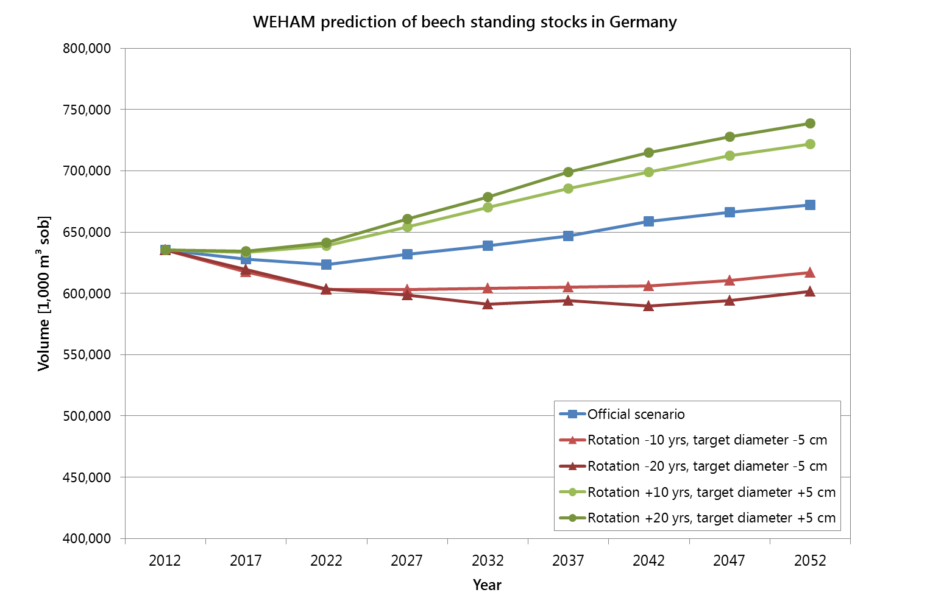
Resource forecasts for Germany: Standing stocks – beech

Slide 5
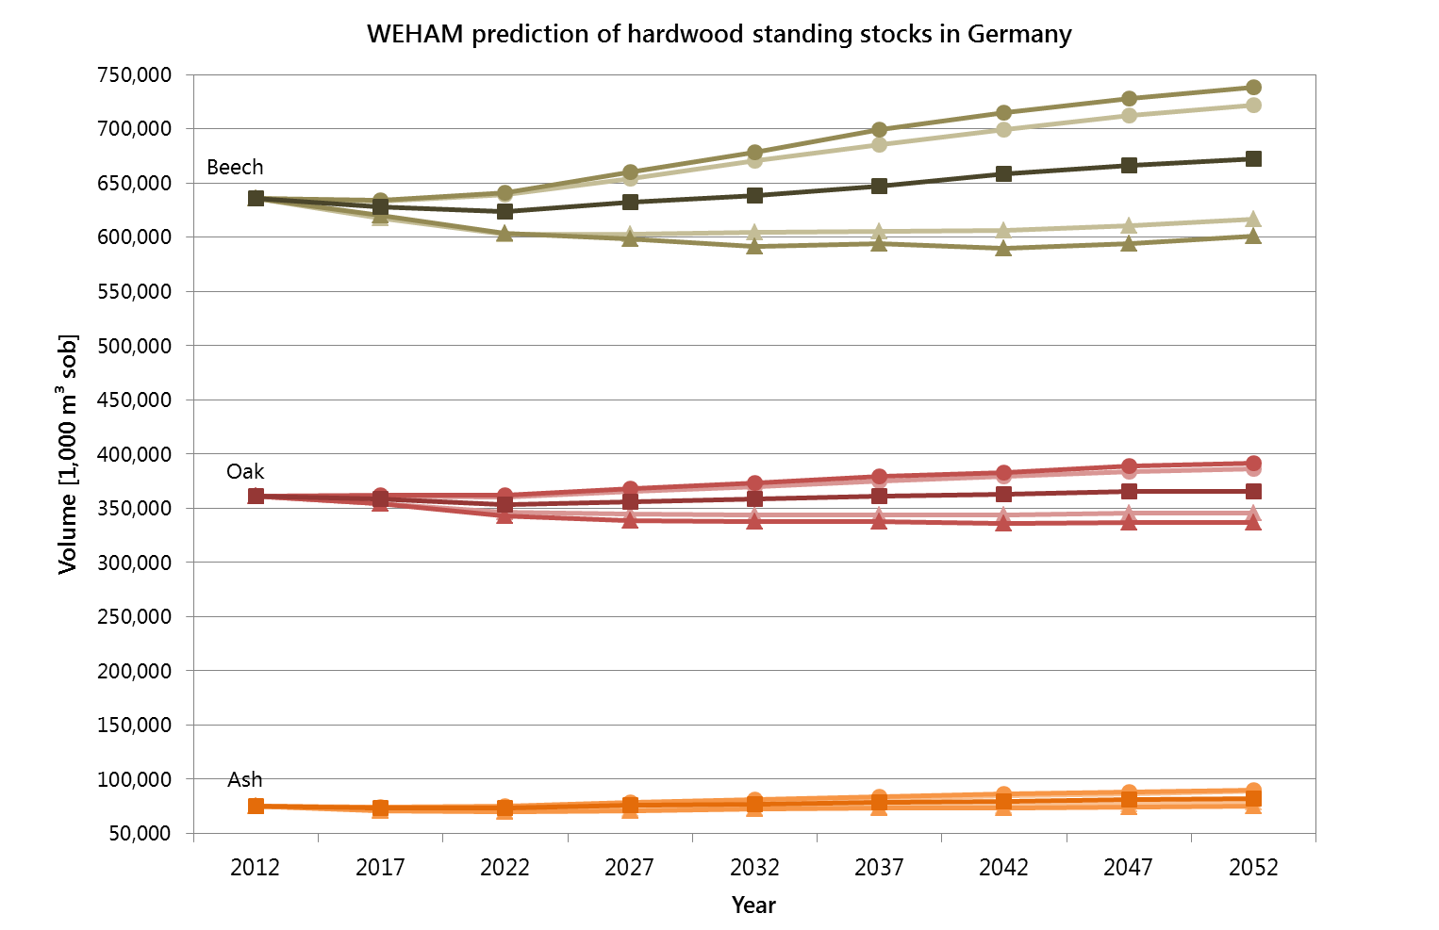
Resource forecasts for Germany: Standing stocks
Difference: 20.4%
Difference: 9.8%
Difference: 8.3%
Difference: 15.1%
Difference: 9.4%
Difference: 17.9%

Slide 6
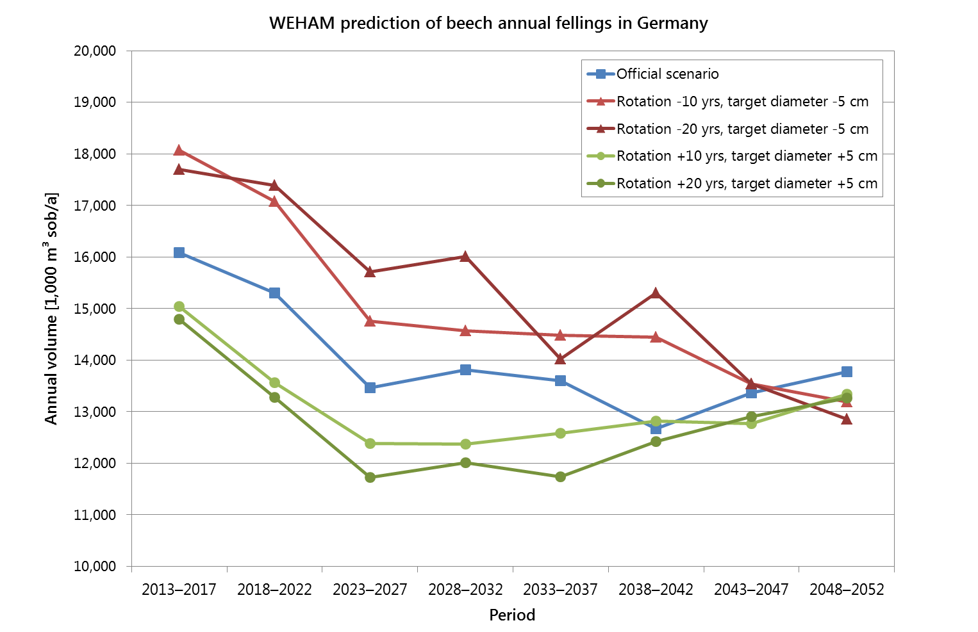
Resource forecasts for Germany: Annual fellings – beech

Slide 7
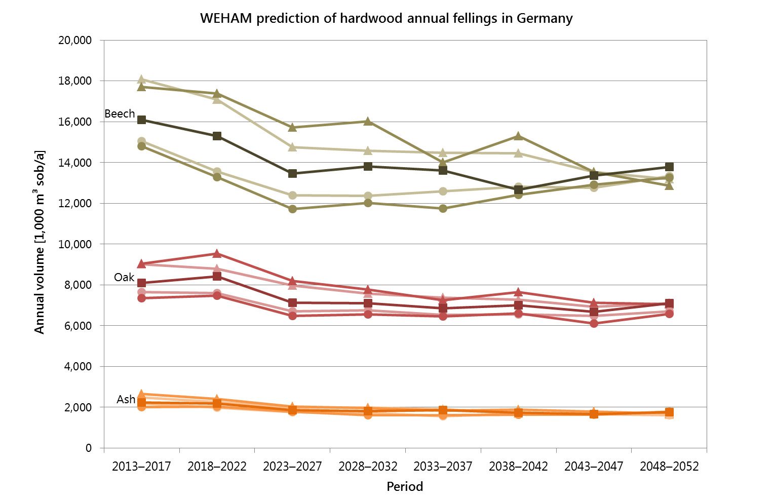
Resource forecasts for Germany: Annual fellings

Slide 8
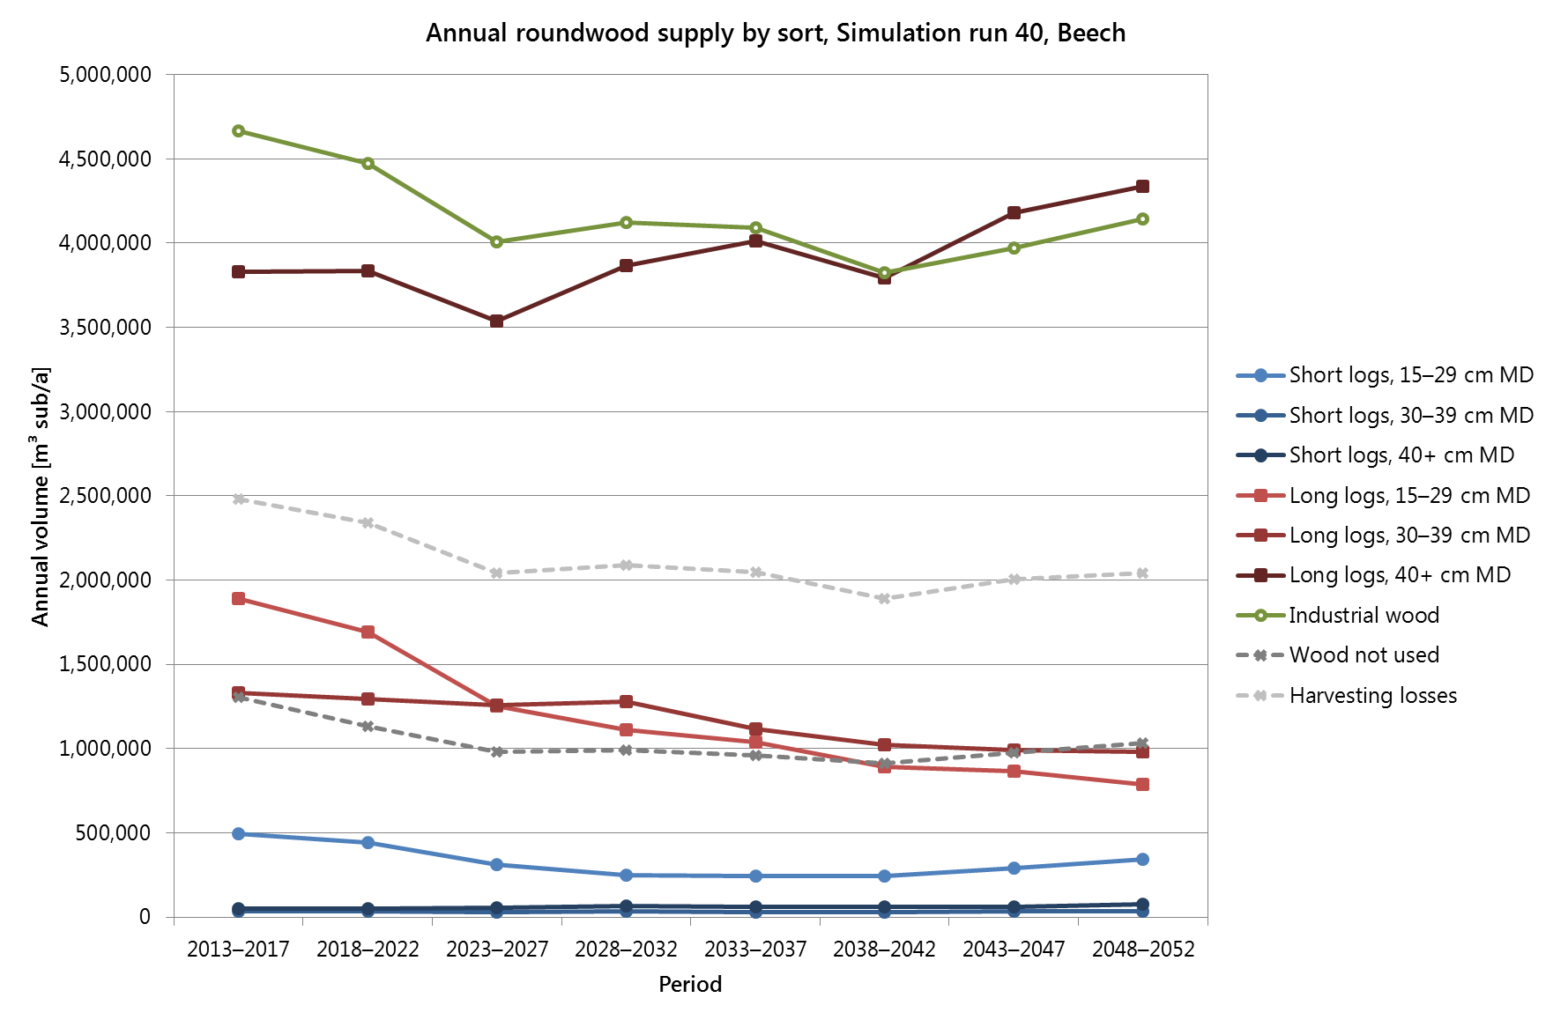
Resource forecasts for Germany: Annual roundwood supply – beech
Sawlogs
2013–2017 | 2018–2022 | 2023–2027 | 2028–2032 | 2033–2037 | 2038–2042 | 2043–2047 | 2048–2052
7,626,730 | 7,347,235 | 6,438,935 | 6,600,706 | 6,500,007 | 6,063,471 | 6,418,028 | 6,555,194

Slide 9
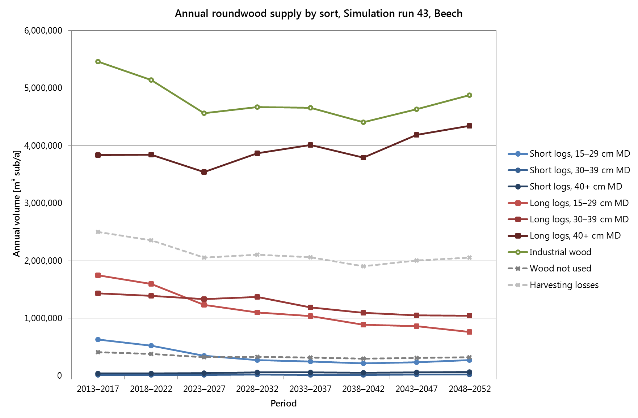
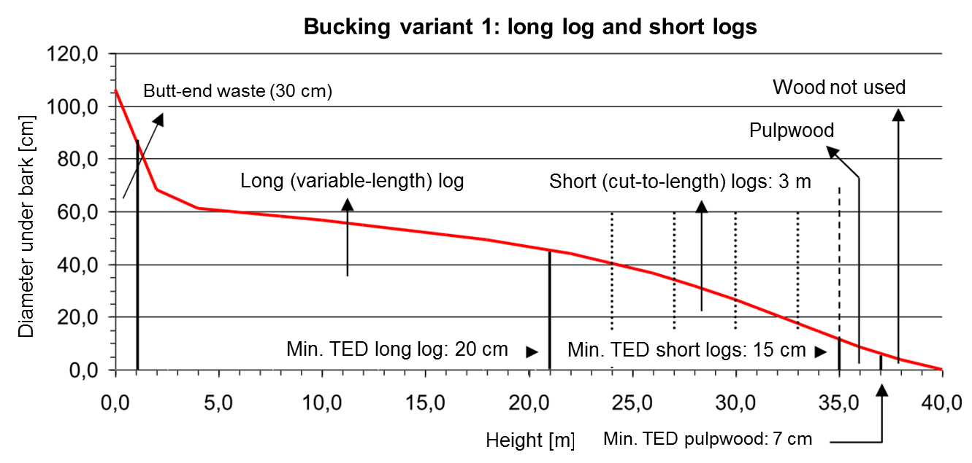
Resource forecasts for Germany: Annual roundwood supply – beech
Bucking variants tested:
Sawlogs
2013–2017 | 2018–2022 | 2023–2027 | 2028–2032 | 2033–2037 | 2038–2042 | 2043–2047 | 2048–2052
7,704,750 | 7,414,256 | 6,522,697 | 6,697,902 | 6,562,258 | 6,059,122 | 6,418,480 | 6,516,681

Slide 10
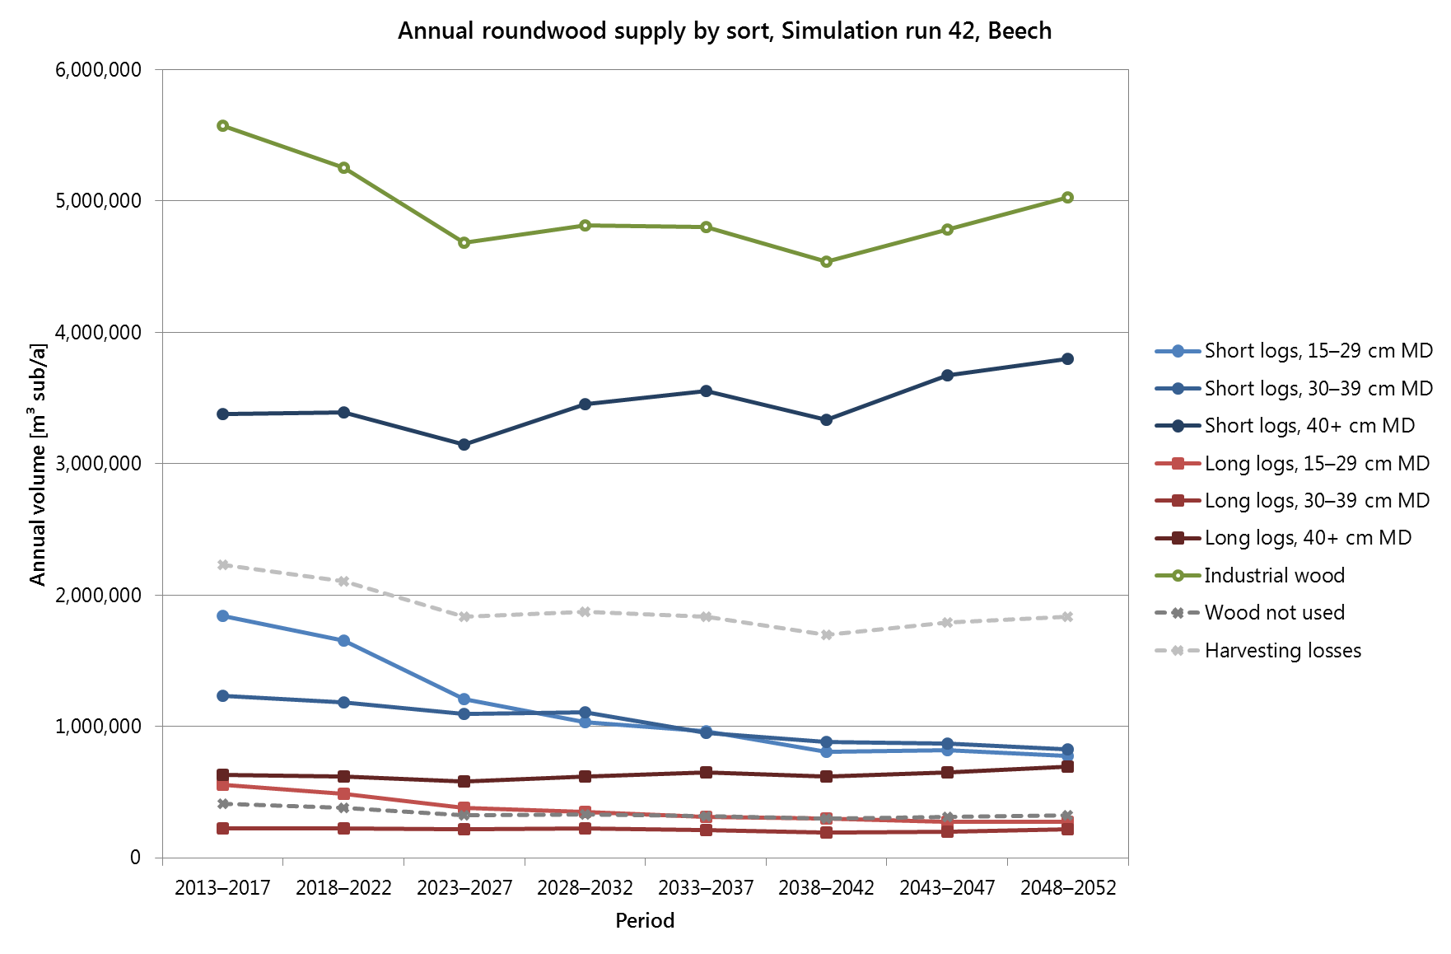
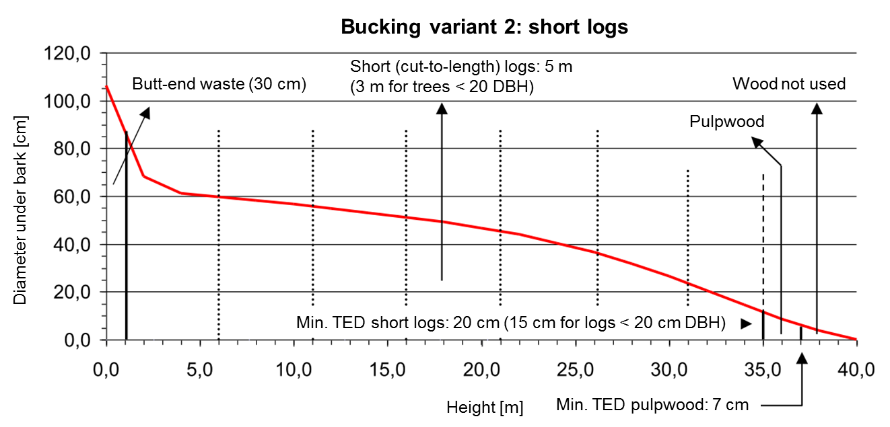
Resource forecasts for Germany: Annual roundwood supply – beech
Bucking variants tested:
Sawlogs
2013–2017 | 2018–2022 | 2023–2027 | 2028–2032 | 2033–2037 | 2038–2042 | 2043–2047 | 2048–2052
7,858,322 | 7,557,170 | 6,622,111 | 6,786,222 | 6,640,376 | 6,130,794 | 6,483,916 | 6,584,895
Notes:
„Pulpwood“ ist das Industrieholz („Industrial wood“)
Langholz kommt vor wegen …

Slide 11
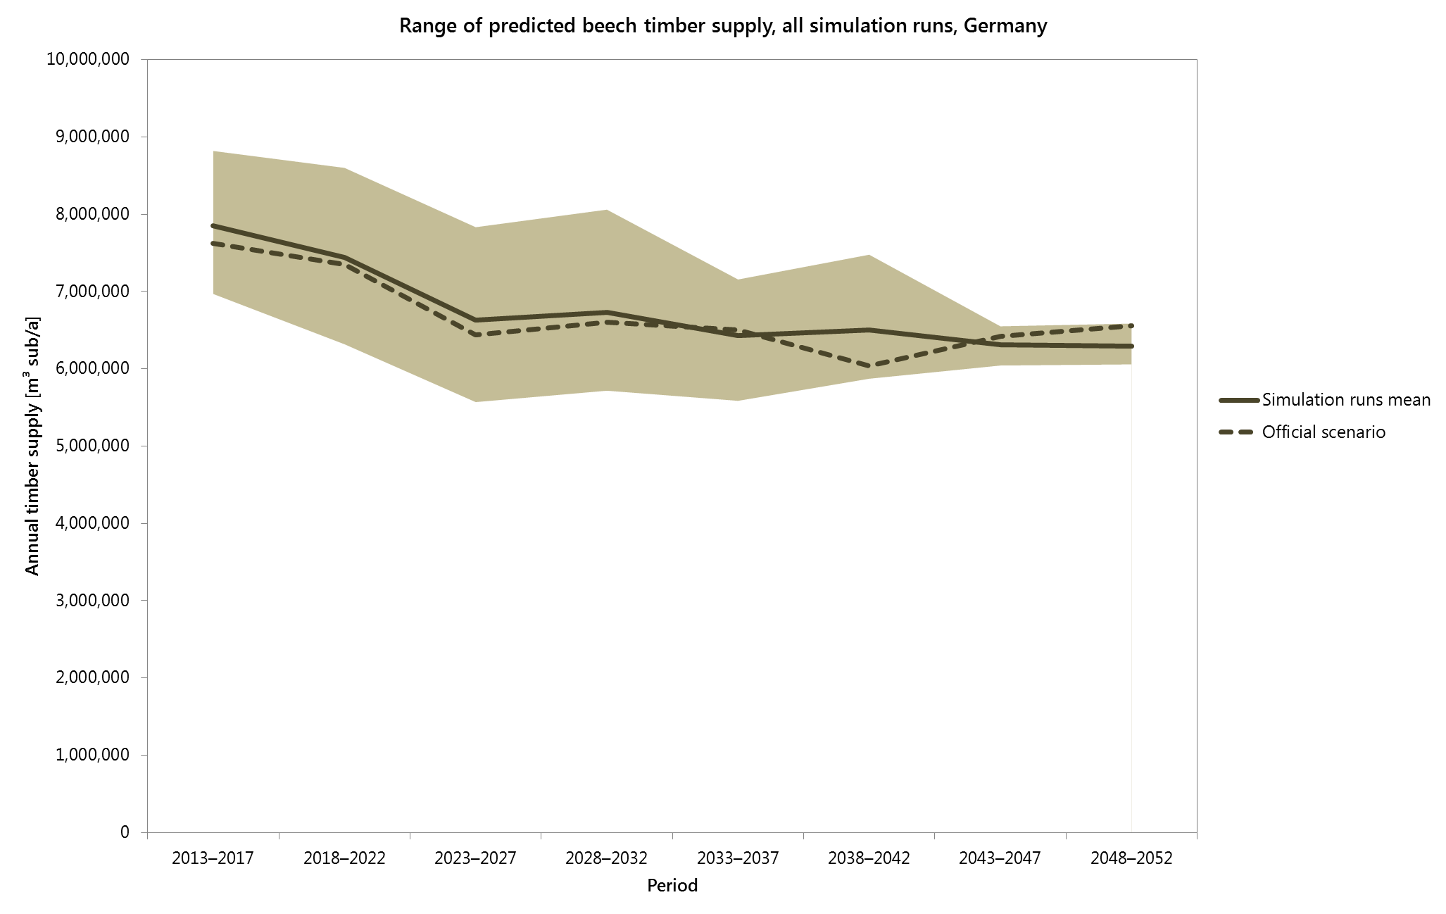
Resource forecasts for Germany: Range of predicted beech timber supply
+12.4%
+15.6%
+18.1%
+19.7%
+15.0%
+11.3%
-11.2%
+3.8%
+4.6%
-15.1%
-4.3%
-3.8%
-15.1%
-13.2%
-9.7%
-16.0%
Notes:
Maximum range in period 2028–2032 with ~35%, minimum in period 2043–2047 with 8%

Slide 12
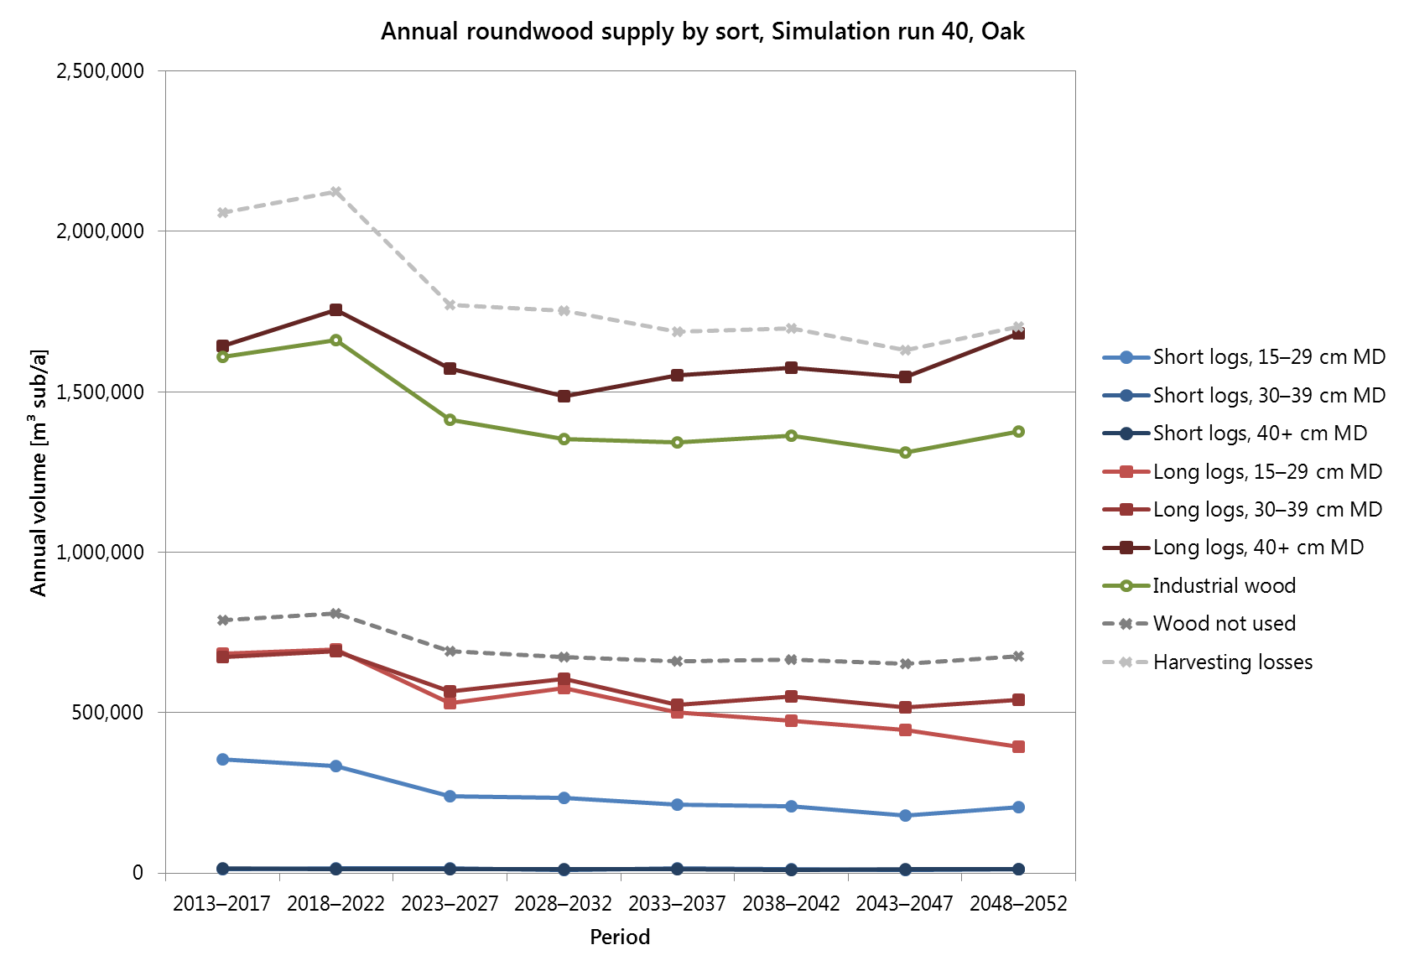
Resource forecasts for Germany: Annual roundwood supply – oak
Sawlogs
2013–2017 | 2018–2022 | 2023–2027 | 2028–2032 | 2033–2037 | 2038–2042 | 2043–2047 | 2048–2052
3,379,709 | 3,502,614 | 2,929,894 | 2,924,410 | 2,816,082 | 2,827,123 | 2,705,660 | 2,846,483

Slide 13
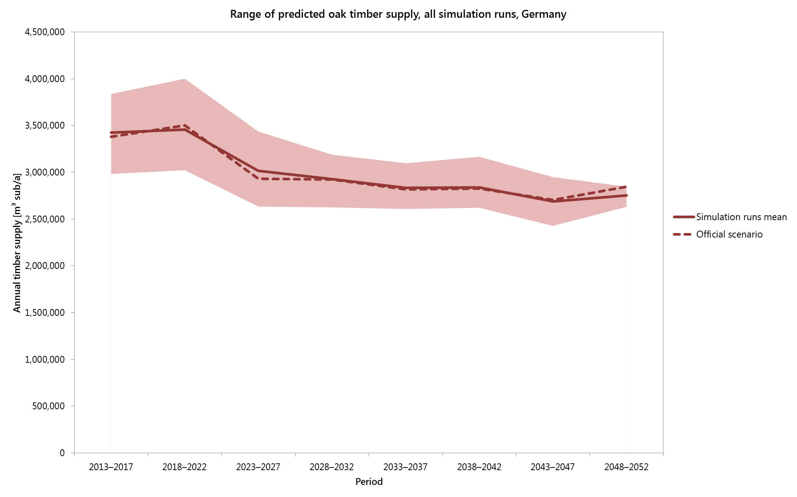
Resource forecasts for Germany: Range of predicted oak timber supply
+15.7%
+12.1%
+14.0%
+9.0%
+9.3%
+11.5%
+9.6%
+3.3%
-12.9%
-12.6%
-12.6%
-10.3%
-7.9%
-7.7%
-4.5%
-9.8%
Notes:
Maximum range in period 2018–2022 with ~28%, minimum in period 2048–2052 with ~8%

Slide 14
Resource forecasts for Austria: Data origin and adaptation
Data from last national forest inventory in Austria (“ÖWI”, 2007–2009)
Adaptation of the data: generating database tables as required by the WEHAM software (provided by Wolfgang Russ, BFW)
In WEHAM: growth models and models of silvicultural treatment specific for federal states; models for Bavaria applied to Austrian data in the simulations

Slide 15
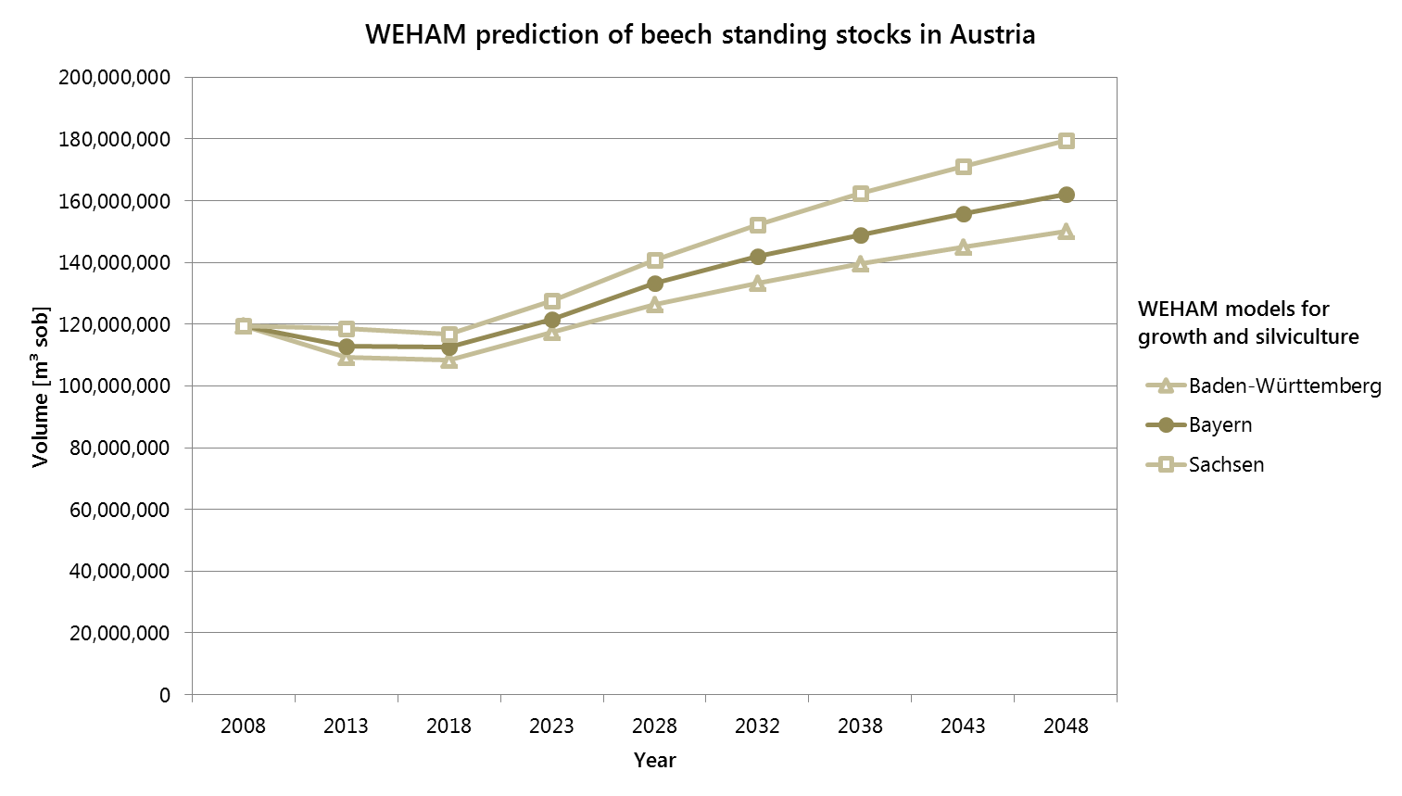
Resource forecasts for Austria: Testing of different models

Slide 16
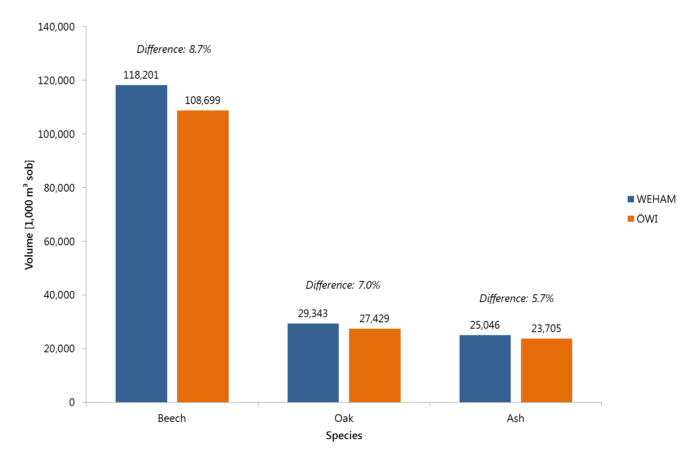
Resource forecasts for Austria: Differences between WEHAM and ÖWI
Tree volume calculation models in WEHAM include branches >7 cm
ÖWI: only bole volume taken into account

Slide 17
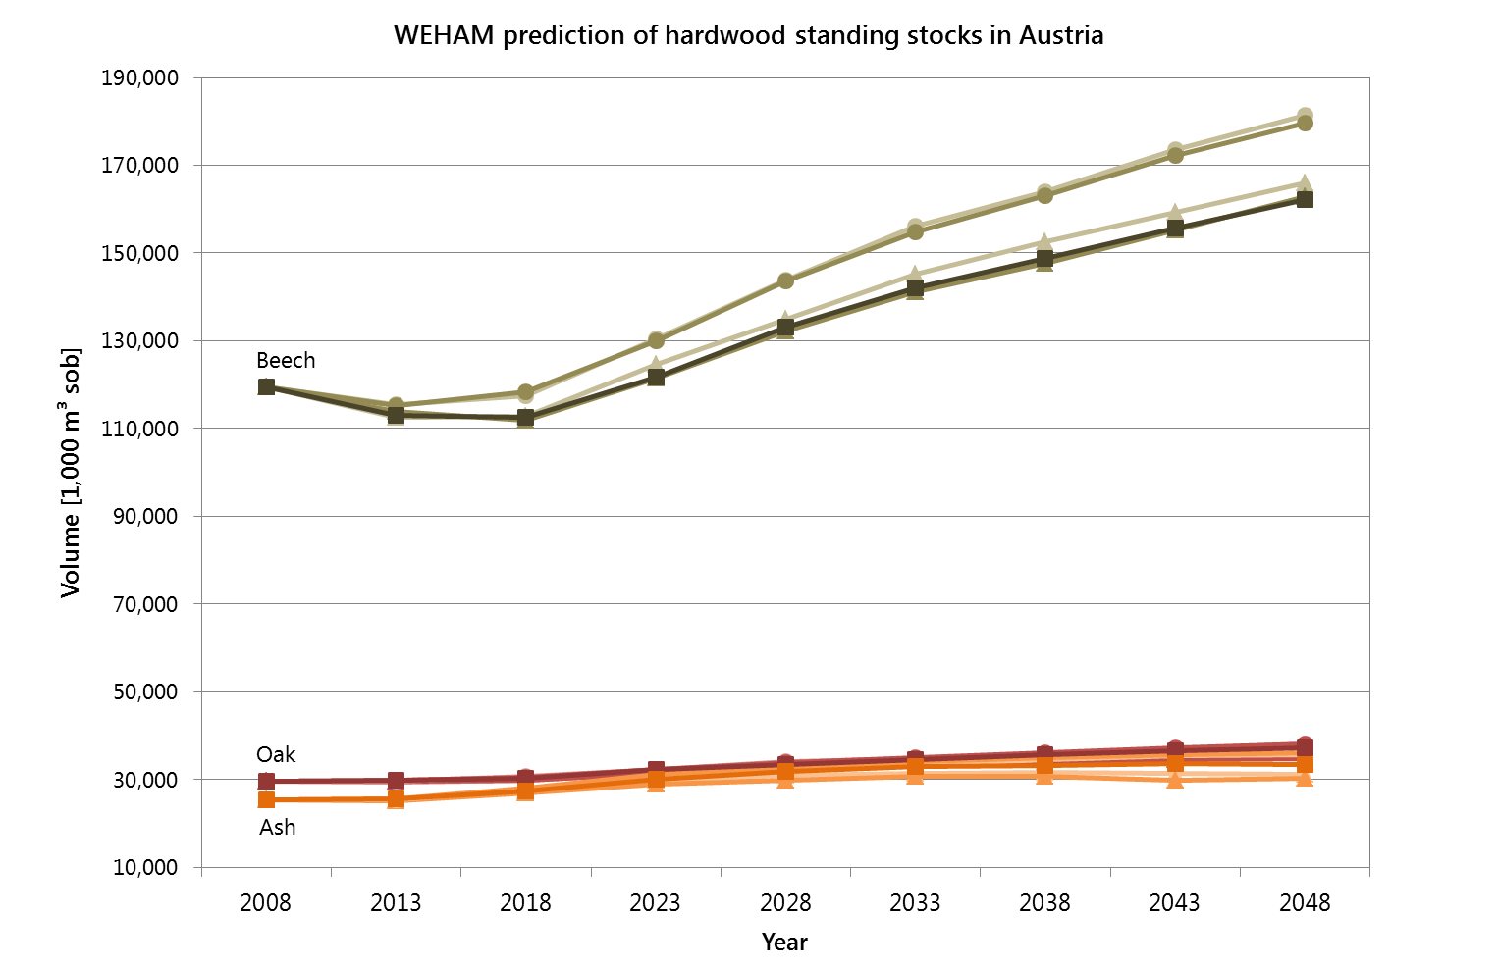
Resource forecasts for Austria: Standing stocks
Difference: 11.9%
Difference: 7.3%
Difference Oak: 3.0%
Difference Oak: 8.9%
Difference Ash: 7.1%
Difference Ash: 17.2%

Slide 18
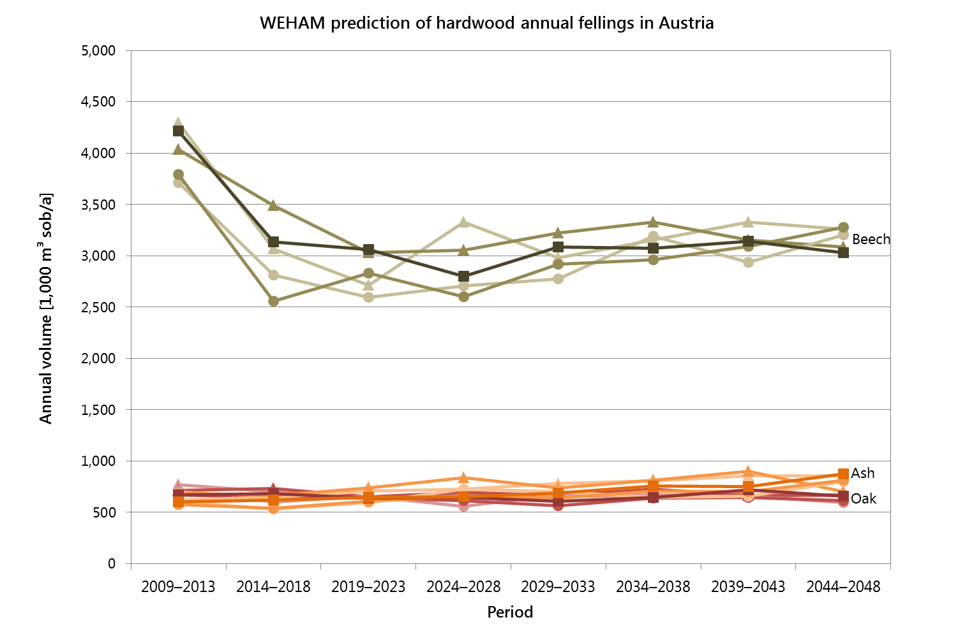
Resource forecasts for Austria: Annual fellings

Slide 19
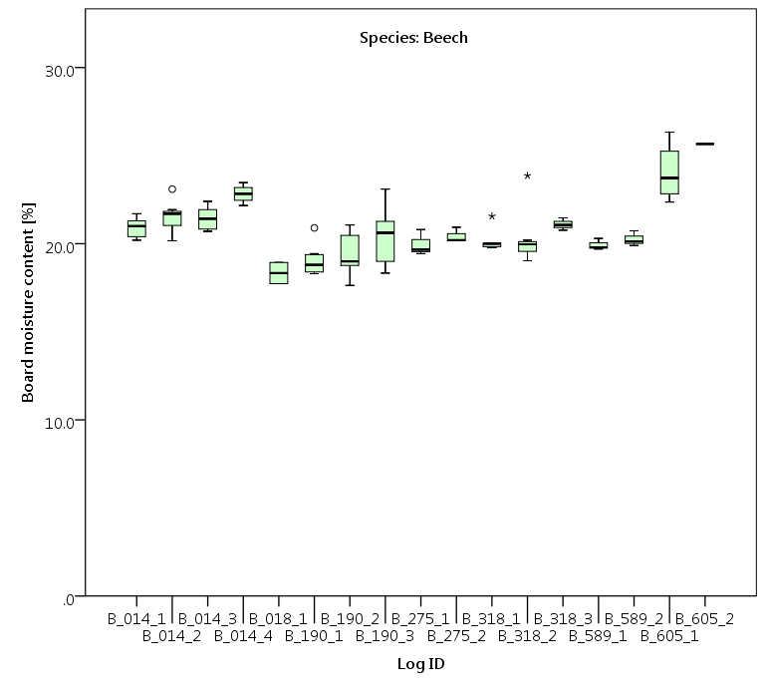
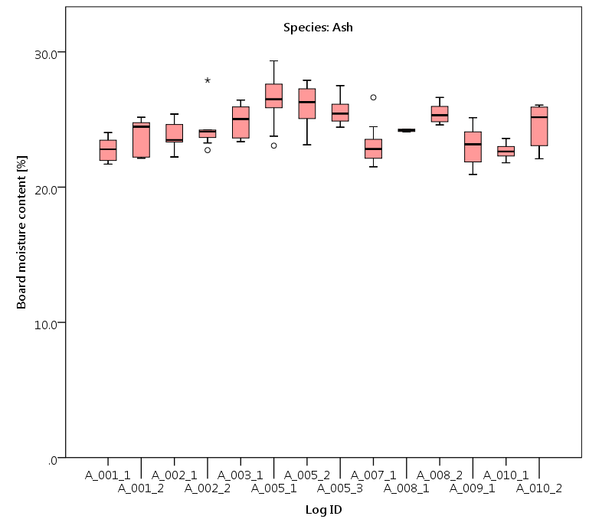
Characterization of beech and ash timber: Log and board MOE_{dyn}
Determination of board MOE_{dyn} by ViScan measuement before kiln-drying
Measurement of board moisture content (boards have been air-dried for ~3 months)

Slide 20
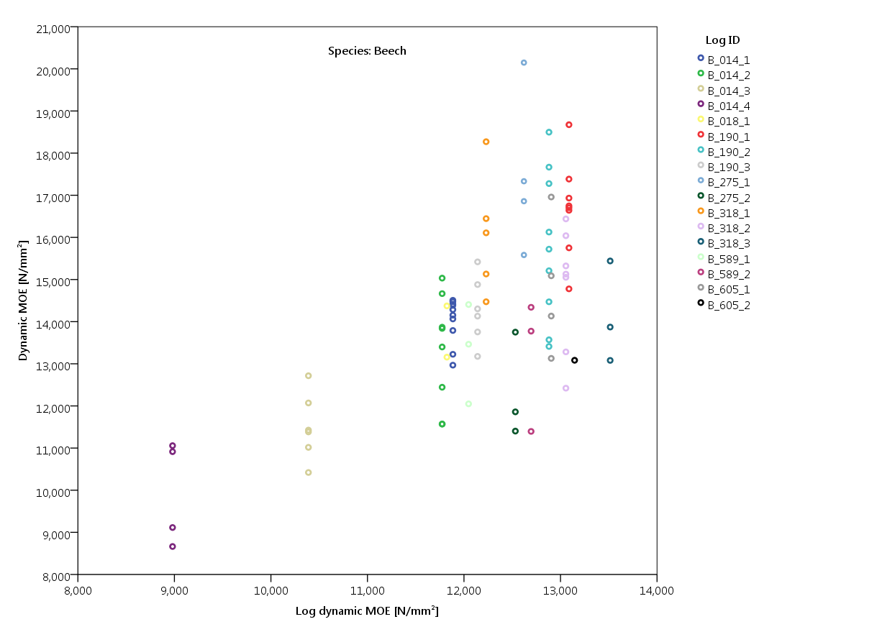
Characterization of beech and ash timber: Log and board MOE_{dyn}
Notes:
Correlation log MOE ~ board MOE 0.654** (sig. at alpha=0.01)

Slide 21
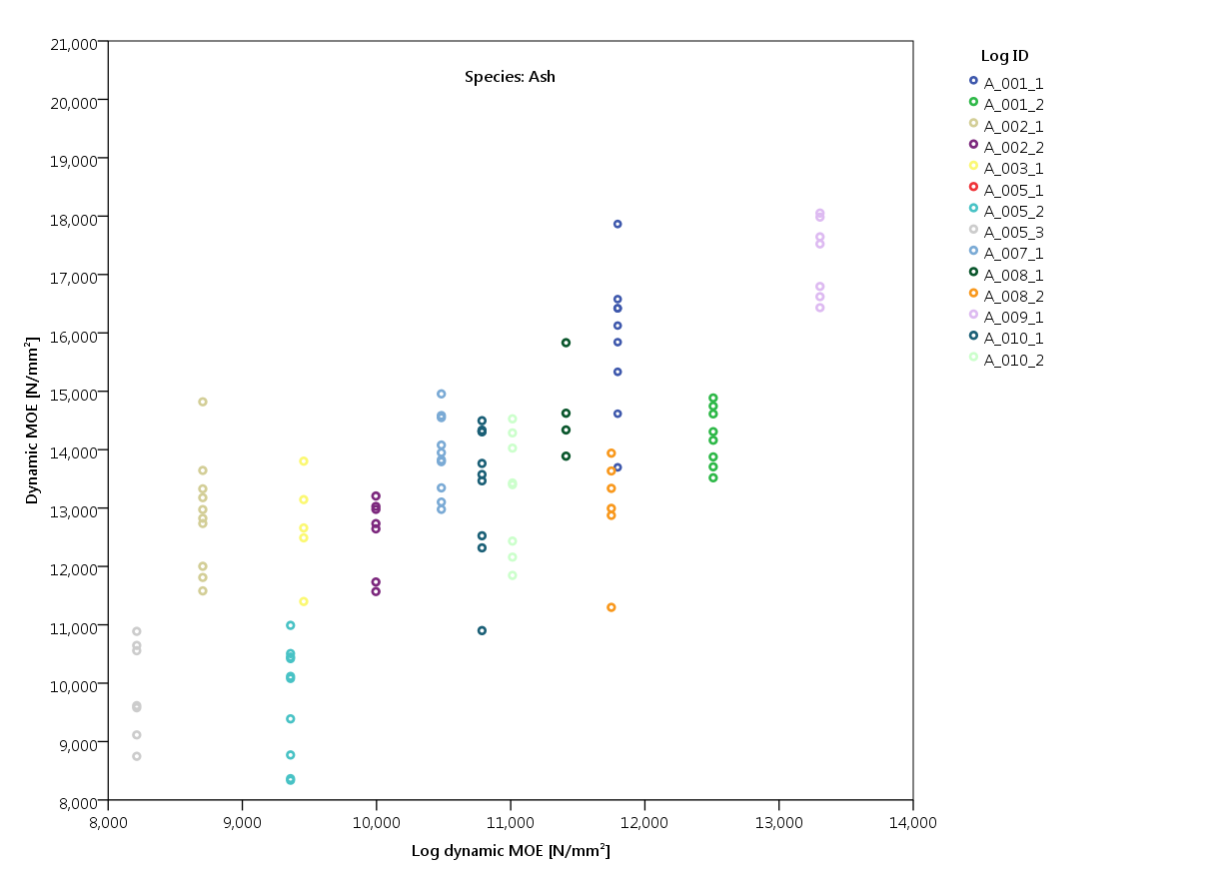
Characterization of beech and ash timber: Log and board MOE_{dyn}
Notes:
Correlation log MOE ~ board MOE 0.734** (sig. at alpha=0.01)

Slide 22
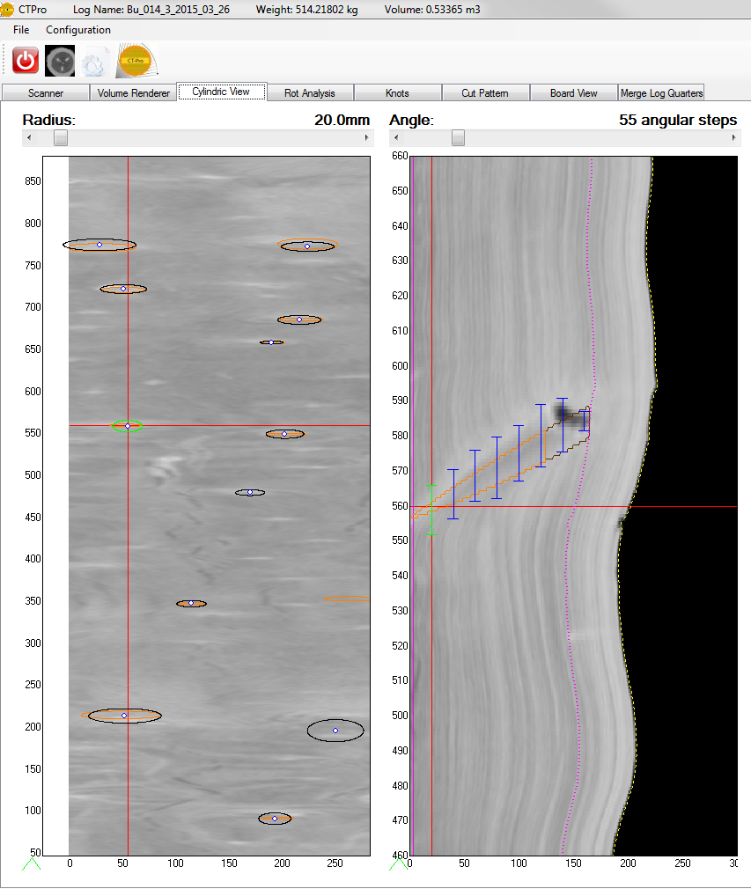
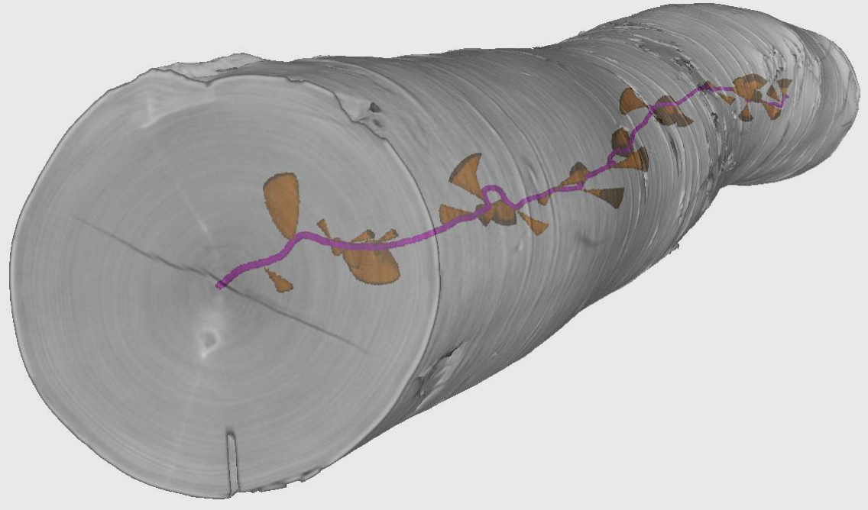
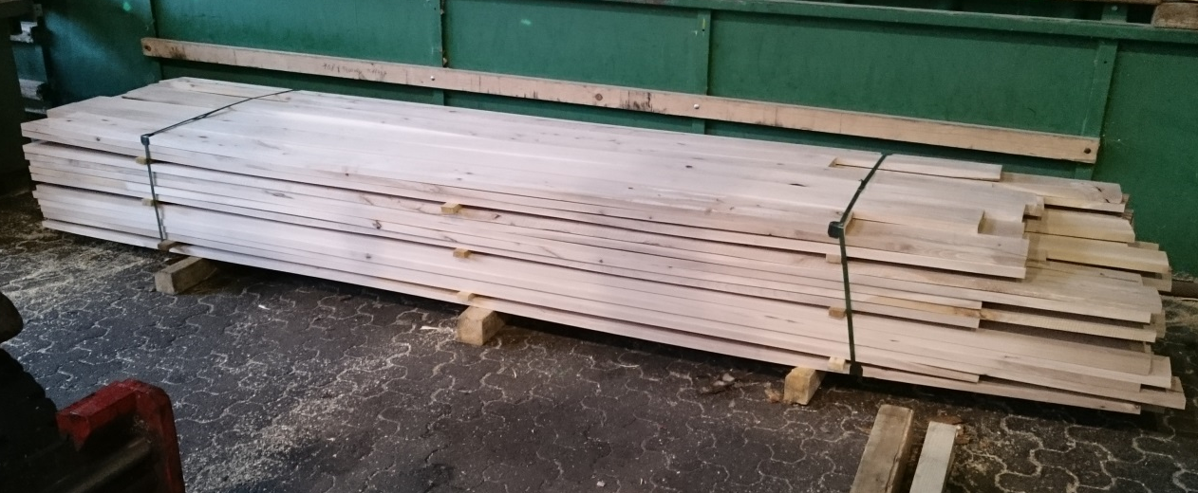
Other recent activities
Kiln-drying and planing of beech/ash boards; shipping to HFA next week
Manual marking of knots in the CT images of the beech logs
Testing of knot detection software on oak and ash: no satisfactory results

Slide 23
Next steps
Analysis of roundwood supply with Austrian data
Strength testing of the beech/ash boards at HFA
Same procedure with the chestnut and oak sample logs: sawing, determination of board MOE_{dyn}, kiln-drying, planing and strength testing
Manual knot marking in CT images of ash, chestnut and oak logs

Slide 24
Thank you for your attention!

Slide 25
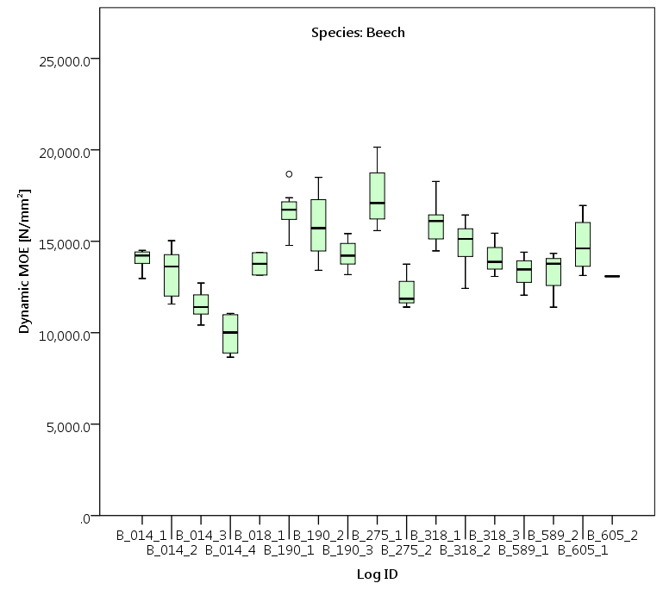
Characterization of beech and ash timber: Log and board MOE_{dyn}

Slide 26
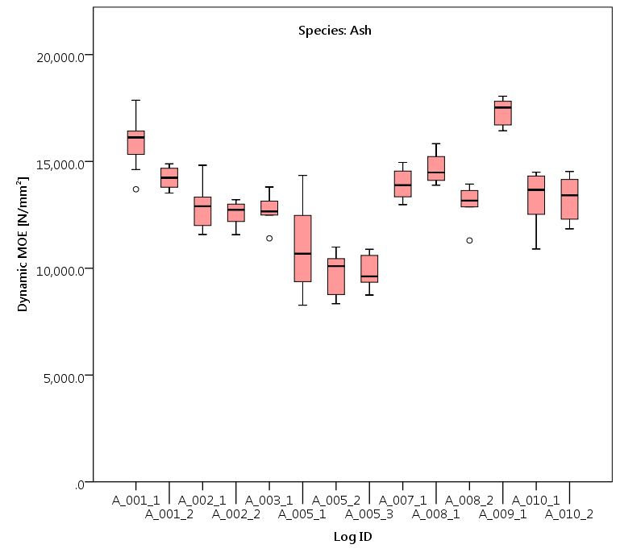
Characterization of beech and ash timber: Log and board MOE_{dyn}

Slide 27
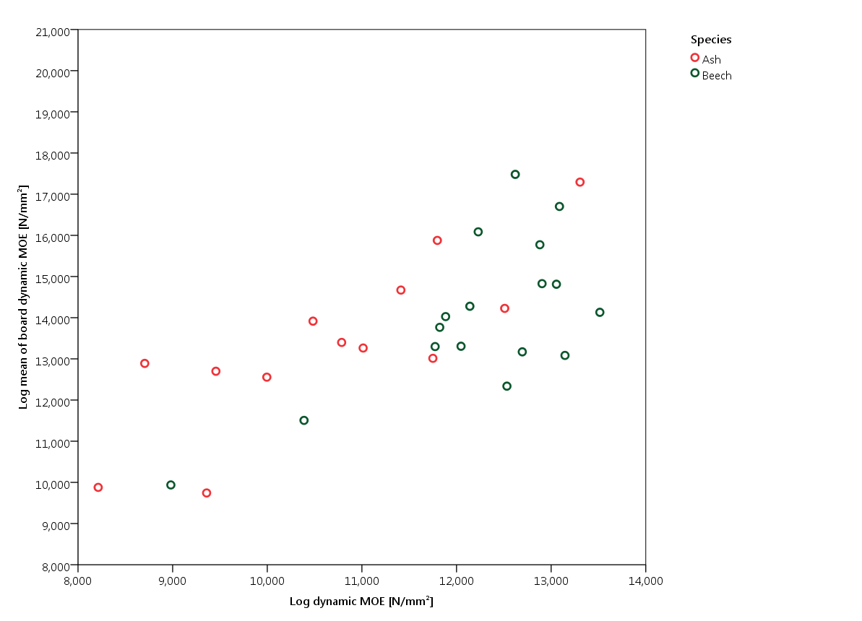
Characterization of beech and ash timber: Log and board MOE_{dyn}
Notes:
Correlation log MOE ~ log mean of board MOE:
Beech: 0.778** (sig. at alpha=0.01)
Ash: 0.834** (sig. at alpha=0.01)

